Slide 1
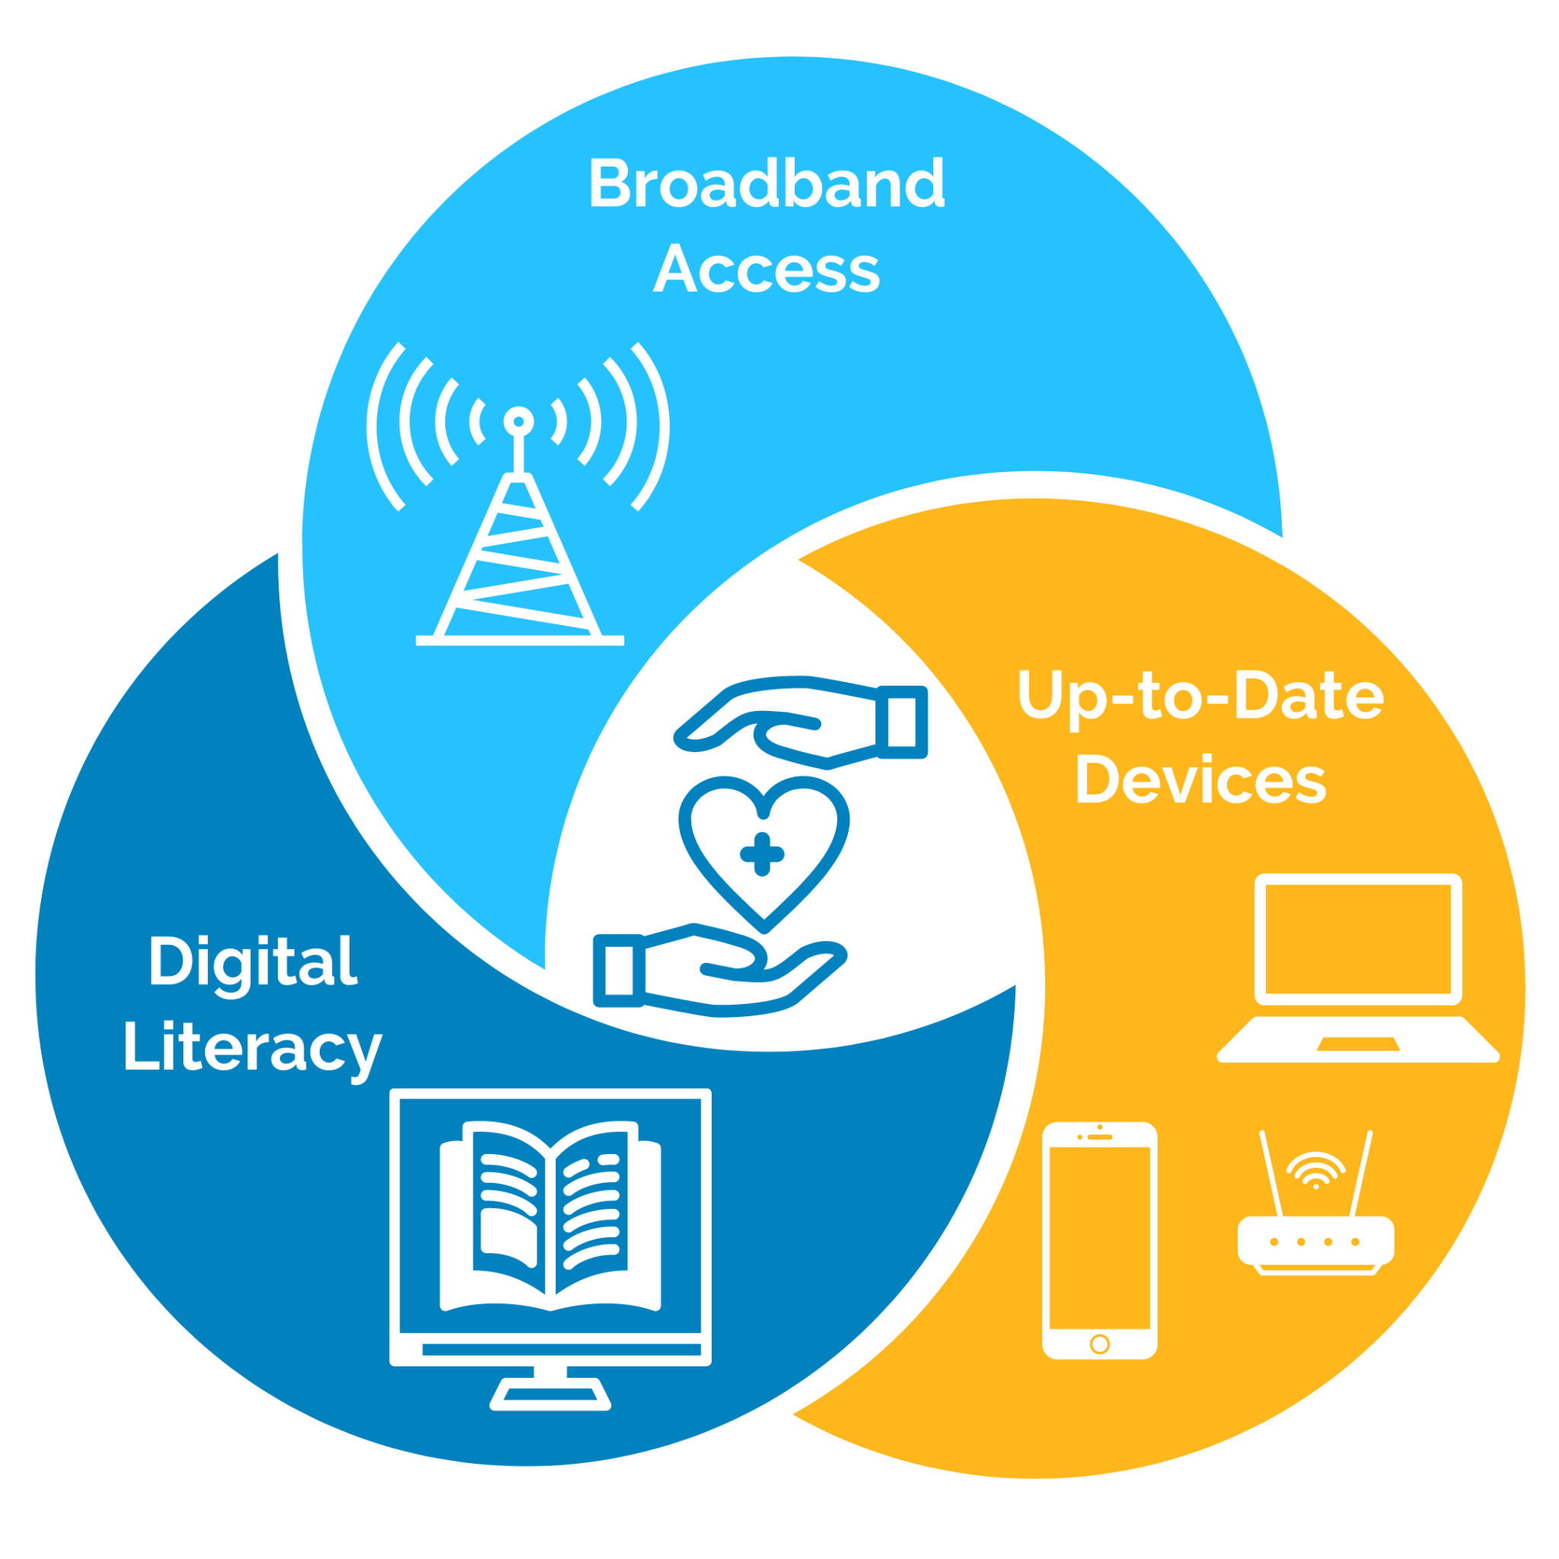


Digital Inclusion as a Social Driver of Health
Jennifer Pruitt, Vice President,
Innovation and Technology, CHF
Aurelia Jones-Taylor, MBA, CEO,
Aaron E. Henry Community Health Services Center

Slide 2

Increased Role of Technology
in Healthcare Access
Electronic Health Records
Patient Portals
Telehealth
Medical Wearables
eRX
Online Scheduling
Pharmacy Apps
Health Education Apps

Slide 3

Disparities in Digital Access
In the US, 29% of low-income households with children do not have access to high-speed internet at home, compared to 7% of higher-income families.
A 2020 report found that 35% of households with incomes below $30,000 lacked a computer, and 43% relied solely on smartphones for internet access.
In rural areas (often home to a high concentration of immigrant and agricultural worker families), 23% of households lack broadband internet.
Immigrant households face higher rates of digital exclusion, with 37% of Hispanic immigrant families lacking home broadband compared to 25% of US-born Hispanic families.
During the COVID-19 pandemic, low-income and immigrant families faced challenges in accessing telehealth services, with 27% of low-income families reporting difficulty using telehealth platforms due to a lack of reliable internet and digital literacy issues.

Slide 4
Advancing Equity: Digital Inclusion
The Children’s Health Fund
Annual Conference
October 7-9, 2024
Aurelia Jones Taylor, MBA
CEO Aaron E Henry Community Health Services Center, Inc.

Slide 6
WHO WE ARE
Federally Qualified Health Center with 45 Year History
Serves Six Counties through 12 Locations
  Mississippi Children's Health Project Since 1992
  Three School-Based Clinics
  Two MMUs Serving 25 Schools in 5 Rural Counties
  Five Free-Standing Clinics – Recently Acquired The Children’s Clinic of Clarksdale
160 Diverse Employees
Over 11,000 Patients Served

Slide 7
WHO WE SERVE
County | 2020 Population | Percent Below Poverty | Median Household Income | Racial/Ethnic Groups
 |  |  |  | W | AA | H
Coahoma | 21,390 | 38.2% | $29,121 | 20.9% | 77.6% | 1.7%
Panola | 33,208 | 22.8% | $38,304 | 48.2% | 50.1% | 2.2%
Quitman | 6,176 | 35.0% | $25,283 | 26.5% | 71.7% | 1.8%
Tallahatchie | 12,715 | 37.9% | $29,864 | 40.2% | 57.0% | 6.9%
Tunica | 9,782 | 28.1% | $39,370 | 20.2% | 77.6% | 2.5%
Tate | 28,064 | 15.1% | $51,030 | 67.1% | 30.9% | 2.8%
MISSISSIPPI TOTALS
Mississippi | 2,961,279 | 19.6% | $45,081 | 59.1% | 37.8% | 3.4%
Socio-demographic Data
Source: U.S Census Quick Facts, MS

Slide 8
WHO WE SERVE
Over 60% Non-White Compared to 38% Statewide
Average Median Household Income $31,000
30.65% Below FPL Compared to 20.8% Statewide
Entire Service Area is HPSA, DPSA and MUA
High School Graduation Rate 80% Compared to 84% State
Higher Unemployment Rate in Delta Counties 6% vs 4.8%
High rate of Medicaid/CHIP Coverage for Children

Slide 9
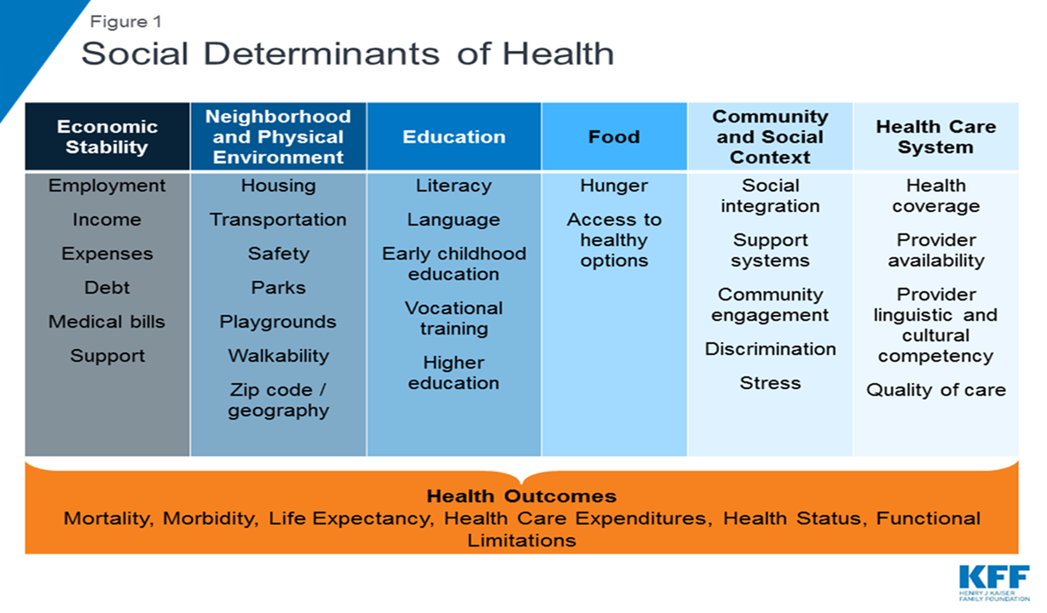
The conditions in the environments where people are born, live, learn, work, play, worship, and age that affect a wide range of health, functioning, and quality-of-life outcomes and risks.

Slide 10
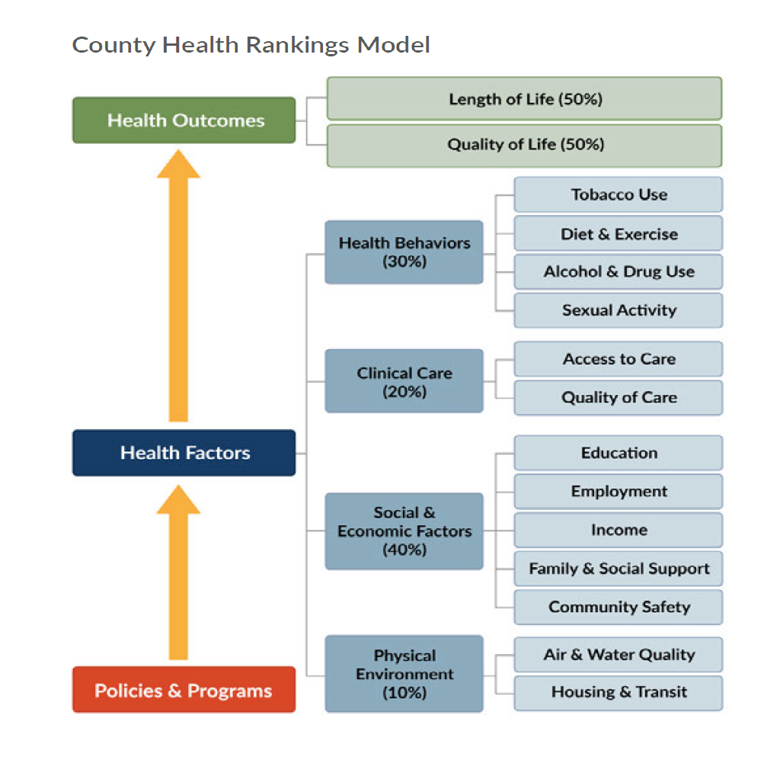
How healthy is your county?: County Health Rankings. County Health Rankings & Roadmaps. (n.d.). Retrieved March 16, 2022, from https://www.countyhealthrankings.org/
Notes:
Aaron E Henry Health Services Clinic has done incredible work to not only provide quality health care to underserved populations., they have committed to their best abilities to responded to the social needs of the community members who seek care in their clinic. But they too like many health care entities realize that the complexities the challenges that their community members have can not can not solely be addressed through their clinical services. Looking at this model that many f you may be familiar with , if we were to look at health outcomes

Slide 11
DISPARITIES IN SDOH
Higher Poverty Rates among AIANs, AAs/Blacks, Hispanics, Compared to Non-Hispanic Whites
Unemployment Rates are 2 Times Higher
Substantial Disparities in Educational Attainment Beyond High School
More Likely to Live in Low-Income and Disadvantaged Neighborhoods
More Likely to be Vulnerable to Losing Insurance Coverage
Higher All-Cause Mortality and Morbidity Rates
High Rates of Overall Disability
Food Insecure
History of Racism and Other Social Inequities
Notes:
Population in the Southeastern Region are more affected

Slide 12
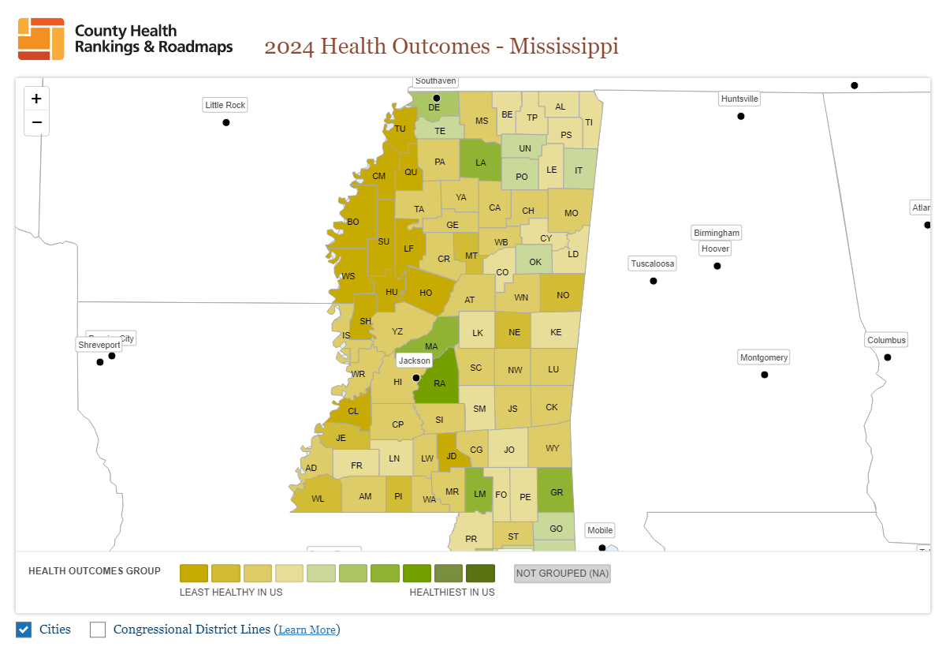

Slide 13
WHY WE ARE HERE
High Area Deprivation Index (ADI)
  income, employment, education, and housing quality.
A graphical scan of the ADI for Mississippi shows areas of extreme high deprivation along Mississippi Delta Region.
  Lack of Broadband Availability
  Low Utilization of Internet at Broadband Speed
  Digital Literacy, Equipment Access
High deprivation scores typically signal a need for targeted interventions and resources to improve health and social conditions in these areas
Notes:
ADI assesses the relative level of Socioeconomic deprivation within a geographical area

Slide 14

Health Equity
Health equity means that everyone has a fair and just opportunity to be as healthy as possible.
This requires removing obstacles to health such as poverty, discrimination, and their consequences, including powerlessness and lack of access to good jobs with fair pay, quality education and housing, safe environments, and health care.
Braveman P, Arkin E, Orleans T, Proctor D, and Plough A. What Is Health Equity? And What Difference Does a Definition Make? Princeton, NJ: Robert Wood Johnson Foundation, 2017.

Slide 15
THE DIGITAL DIVIDE
Computer and Internet Use have Profound Effects
  Individual Empowerment
  Educational Attainment
  Economic Growth
  Community Development
  Accessing Healthcare, Health-related Information, health education and Promotions
Significant Disparities in Computer and Internet Use by Sociodemographic Characteristics
  Black Household less Likely to Own or Use a Computer (Including a Smartphone)
  Black Households less likely to Afford Internet and Have Access to Broadband
  Household Education and Income are Strongly Linked to Computer and Internet Use
  Many Zip Codes Have lower Access to Computer and Broadband Internet

Slide 16
TELEHEALTH
Challenges and Opportunities

Slide 17
TELEHEALTH UTILIZATION
Mostly Used For Behavioral Health
  Referral Based on Depression Screen Score
  Reports of Panic Disorders
  Suicidal Ideation
Followed by Primary Care (Adults)
  Chronic Care Management
  Remote Patient Monitoring
Referral Management (Pending)

Slide 18
TELEHEALTH CHALLENGES
TECHNOLOGY
  Connectivity – MS BEAM Initiative
  Literacy
  Device Access
  Cost
DEPLOYMENT
  Provider Use
  Reimbursement Issues
  May Not Be Effective

Slide 19
Working Together to Improve Digital Inclusion

Slide 20

Identify stakeholders
Plan 2 -3 initial community events, at a variety of locations, days, times. Consider adding a virtual option.
Invite representatives from all stakeholder groups
Set clear goal and objectives
Create broad agenda with guided open discussions
Establish fair & respectful ground rules
Listen more than you talk
Ask questions
Community Engagement

Slide 21

Subsidized internet programs
  ACP (ended June 1, 2024)
  Lifeline
Corporate programs
  T Mobile Project 10 Million
  Verizon Project Forward
  Access from AT&T
  Optimum Advantage Internet
  Spectrum Internet Assist
Guest wi-fi on mobile units
Expand community wi-fi hotspots
Expanded Access
to Fast, Reliable Internet

Slide 22
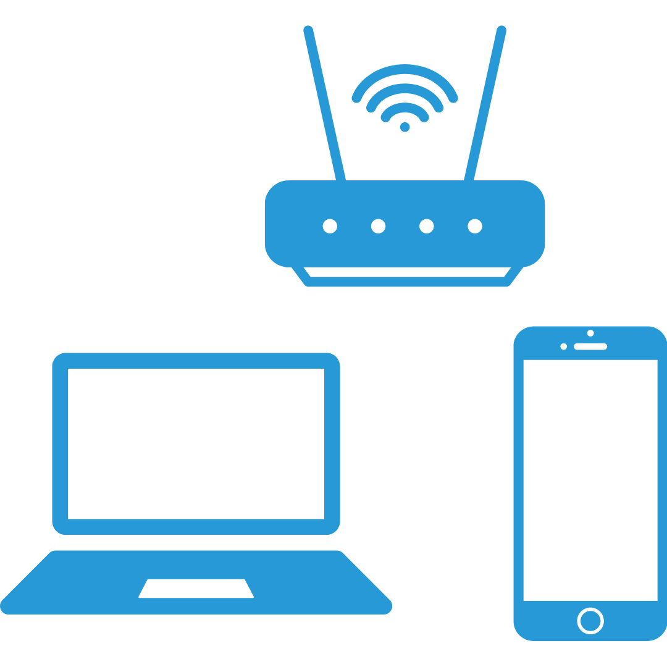
Free or subsidized device programs
  ACP (ended June 1, 2024)
  Some Lifeline providers give free tablets (StandUp Wireless)
  PCs for People
  human-i-t
Local nonprofits or government programs
Device donation drives
Expanded Access
to Up-to-Date Devices

Slide 23
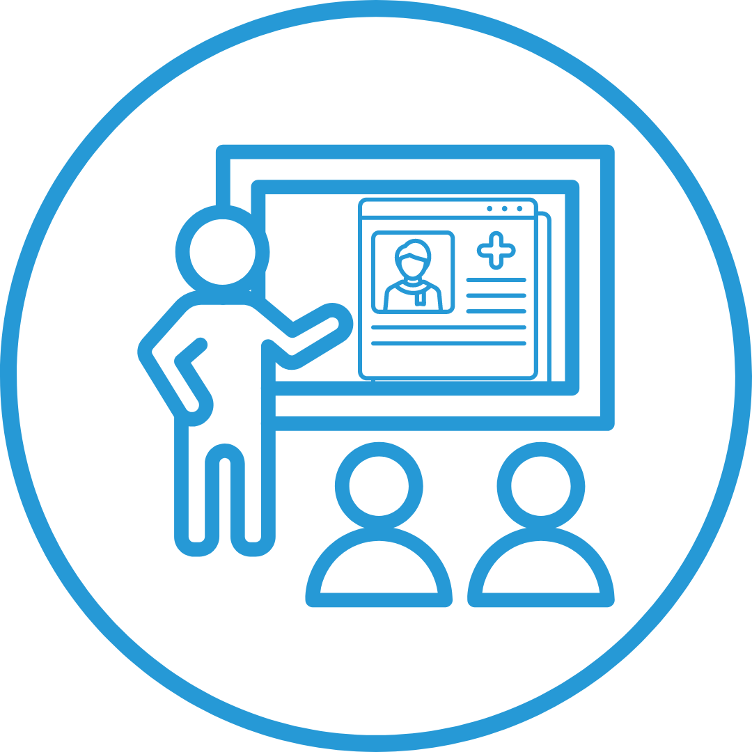
Staff training
Develop clinic-specific digital support materials or videos for your patients
Youth digital health ambassador programs
Digital health literacy workshops (in person)
Digital health literacy trainings (virtual)
Digital Health Literacy

Slide 24
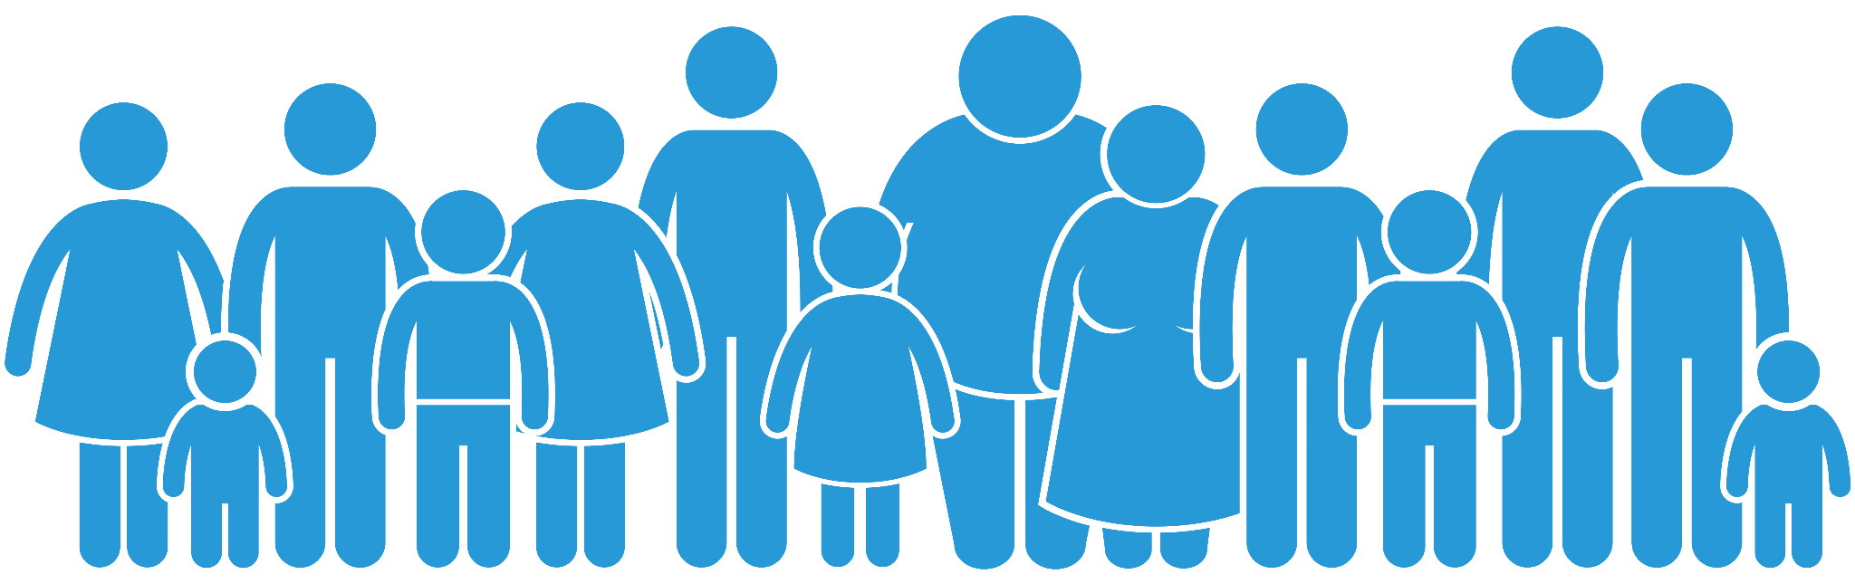
Community Activities to Increase Digital Health Equity
Community wi-fi hotspots
Community digital health literacy workshops
Library-based tech education programs
Feature digital health education at health fairs
Telehealth awareness campaigns
Culturally tailored digital education campaigns

Slide 25



Equity Requirements for Digital Health Platforms
Simplified, Low-Bandwidth Options
Culturally Relevant Feature Sets
Leverage mobile phones for health services:
  Phone-based telehealth and telemental health
  Text-based mental health support
Low-bandwidth telehealth options
Multilingual digital health services
  Patient portals
  Telehealth platforms
  Reminder texts
Culturally tailored digital health content, taking into account:
  Cultural differences
  Literacy-levels
  Living situations and economic realities

Slide 26

Policy & Advocacy Efforts for Digital Equity
Infrastructure Investment and Jobs Act (IIJA)
  Broadband and Internet for All
Lifeline Program
The Rural Digital Opportunity Fund (RDOF)
Federal Communications Commission (FCC)
Broadband Mapping
Telehealth Modernization Act of 2024
National Digital Inclusion Alliance (NDIA) Initiatives
State and Local Initiatives
Notes:
Slide 2
CHF’s national network biannual data is finalized for 2023. The Research & Evaluation dept has completed all 2023 data collection and analysis.
Last year, our network saw nearly 113,000 unique clinical patients in over 533, 000 encounters.

Slide 27
Discussion…

Slide 28


