Slide 1

Healthy and Ready to Learn
Angie Vega & Angelika Gutierrez, MPH
10/2024
Notes:
Introduction:
General Sign-In

Slide 2
Introduction
Healthy and Ready to Learn Initiative Overview
HRL is an initiative that addresses health issues that impact children’s learning by bringing services, resources and training to key stakeholders with the goal of promoting student long-term success.
Notes:
Angie
Welcome everyone and thank the audience for joining. Provide a brief background on the Healthy and Ready to Learn (HRL) Initiative and its purpose of addressing health barriers that impact student success. Set the stage by mentioning the presentation will explore disparities, HRL’s unique approach, and how its values guide the work.
Add funding
H&M Foundation
Jaguar Land Rover
Individual Donors
New York City Council
Clementina Foundation
IICF
Ohrstrom Foundation
Individual Donors
Red Nose Day
Mother Cabrini Foundation
COVID-19 Emergency Relief
Hearst Foundation
Individual Donors
Red Nose Day/ Operational Funds

Slide 3
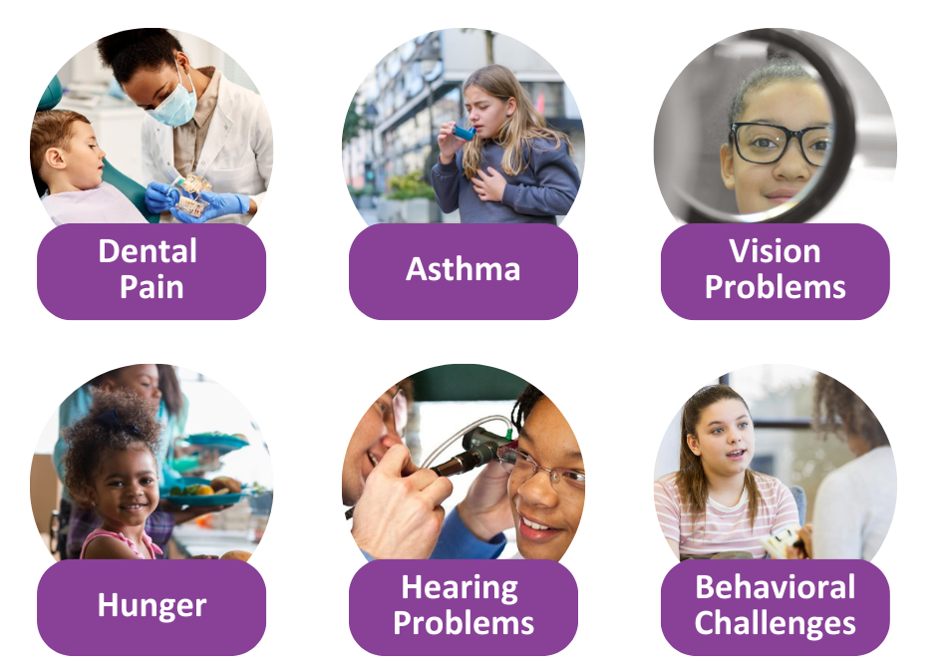
Health Barriers to Learning
Notes:
Angie
As mentioned in the introduction, when we use the term “Health Barriers to Learning” we are referring to health or well-being issues that make it harder for students to be ready to learn while they are at school. While there are many health issues may impact an individual child’s learning, we focus on the following 6: Hearing problems, Vision problems. Uncontrolled Asthma, Dental pain, Hunger, and Mental and Behavioral Health.
Hearing problems affect about 15% of school-aged children in the United States. Most hearing issues are detected during newborn screenings or well-child visits to the pediatrician. In some cases, hearing loss may be noticed as children get older. Hearing problems may impact a child’s ability to develop language skills and meet particular developmental milestones.
Nationally, about 20% of school-aged children have at least one vision problem. In high-need communities, the percentage of students with a vision problem could be higher. Vision problems are hard to detect because a child may not know they are not seeing correctly. Students’ vision should be screened once a year by their doctor. Depending on where you live, vision screenings may be done in schools. In New York City, nearly 30% of children at public schools fail vision screenings. Corrected vision can help make sure students are focused in the classroom and can support a child’s ability to read at grade level.
Asthma impacts about 13% of children in New York City. When asthma is uncontrolled, it can lead to more emergency room visits for children. Uncontrolled asthma is a common cause of missed school days. Students with uncontrolled asthma miss over 13 days of school per year due to asthma. The school absences can impact learning, and may make it difficult for students to sleep, impacting focus in the classroom. Children who have asthma should work with their doctor to create an asthma action plan to keep their asthma well controlled.
There are different dental issues that can cause dental pain, but a common one is untreated tooth decay which could cause cavities. About 17% of school-aged children have untreated decayed teeth. Pain that results because of dental issues can make it hard for students to pay attention in the classroom and could also be the reason for missed days of school. In fact, one study in New York City showed that students were 3 times as likely to miss school if they were experiencing dental pain. Children should visit the dentist twice a year for check-ups and cleanings, but if a child says their tooth hurts, he or she should be visit a dentist as soon as possible.
Hunger or food insecurity affects about 1 in 4 children in New York City. Limited access to food can impact a child’s physical development. In school, children who don’t miss meals, especially breakfast, may be distracted during the school day and have limited energy. Doctors and school staff can help find local resources to support students and families.
Mental Health and Behavior Problems ***
Some students may be impacted by one or multiple of these Health Barriers to Learning. While some schools may have on-site resources and programs to support students and families with particular health issues, some schools may need to refer students and families to local community resources
-------------------------------------------------
https://www.ncbi.nlm.nih.gov/pmc/articles/PMC3222359/
https://drive.google.com/file/d/0B9oDFWZeBQLnb1BpYlFJYVlzVUxGYXRHY3hKQk9zUEtHYlJn/view
Hearing Problems
Niskar AS, Kieszak SM, Holmes A, Esteban E, Rubin C, Brody DJ. Prevalence of Hearing Loss Among Children 6 to 19 Years of Age: The Third National Health and Nutrition Examination Survey. JAMA.1998;279(14):1071–1075.
doi:10.1001/jama.279.14.1071
Vision Problems
Rodriguez E, Srivastava A, Landau M. Increasing Screening Follow-Up for Vulnerable Children: A Partnership with School Nurses. Int J Environ Res Public Health. 2018;15(8):1572.
doi:10.3390/ijerph15081572
Bodack MI1, Chung I, Krumholtz I. An analysis of vision screening data from New York City public schools. Journal of the American Optometric Association. 2010; 81(9):476-84 .
DOI: 10.1016/j.optm.2010.05.006
Asthma
NYC Child Health, Emotional Wellness and Development Survey 2015
https://a816-healthpsi.nyc.gov/epiquery/sasresults.jsp
CDC Asthma-related Missed School Days among Children aged 5–17 Years
https://www.cdc.gov/asthma/asthma_stats/AstStatChild_Missed_School_Days.pdf
Dental Pain
Dye BA, Li X, Beltrán-Aguilar ED. Selected oral health indicators in the United States, 2005–2008. NCHS data brief, no 96. Hyattsville, MD: National Center for Health Statistics. 2012.
https://www.cdc.gov/nchs/products/databriefs/db96.htm#citation
Stephanie L. Jackson, DDS, MS,corresponding author William F. Vann, Jr, DMD, PhD, Jonathan B. Kotch, MD, MPH, Bhavna T. Pahel, PhD, MPH, BDS, and Jessica Y. Lee, DDS, PhD, MPH. Impact of Poor Oral Health on Children's School Attendance and Performance. American Journal of Public Health. 2011 October; 101(10): 1900–1906.
doi: 10.2105/AJPH.2010.200915
Hunger
New York City’s Meal Gap 2016 Trend Report
https://www.foodbanknyc.org/wp-content/uploads/Meal-Gap-Trends-Report-2016.pdf
Behavioral Health
Perou R, Bitsko RH, Blumberg SJ, Pastor P, Ghandour RM, Gfroerer JC, Hedden SL, Crosby AE, Visser SN, Schieve LA, Parks SE, Hall JE, Brody D, Simile CM, Thompson WW, Baio J, Avenevoli S, Kogan MD, Huang LN; Centers for Disease Control and Prevention (CDC). Morbidity and Mortality Weekly Report. 2013 May 17;62(2):1-35.
Simon AE, Pastor PN, Reuben CA, Huang LN, Goldstrom ID. Use of Mental Health Services by Children Ages Six to 11 With Emotional or Behavioral Difficulties. Psychiatr Serv. 2015;66(9):930–937. doi:10.1176/appi.ps.201400342

Slide 4
Maps and Disparities
Identifying Health and Educational Barriers
Visualizing the disparities across NYC to highlight areas of high need and the impact of health barriers on learning.
Notes:
Angie
Discuss the significance of the maps by highlighting regions in NYC with high poverty, chronic absenteeism, or health issues like asthma and vision problems. Make the connection between these disparities and educational challenges. Emphasize why HRL targets these communities.

Slide 5
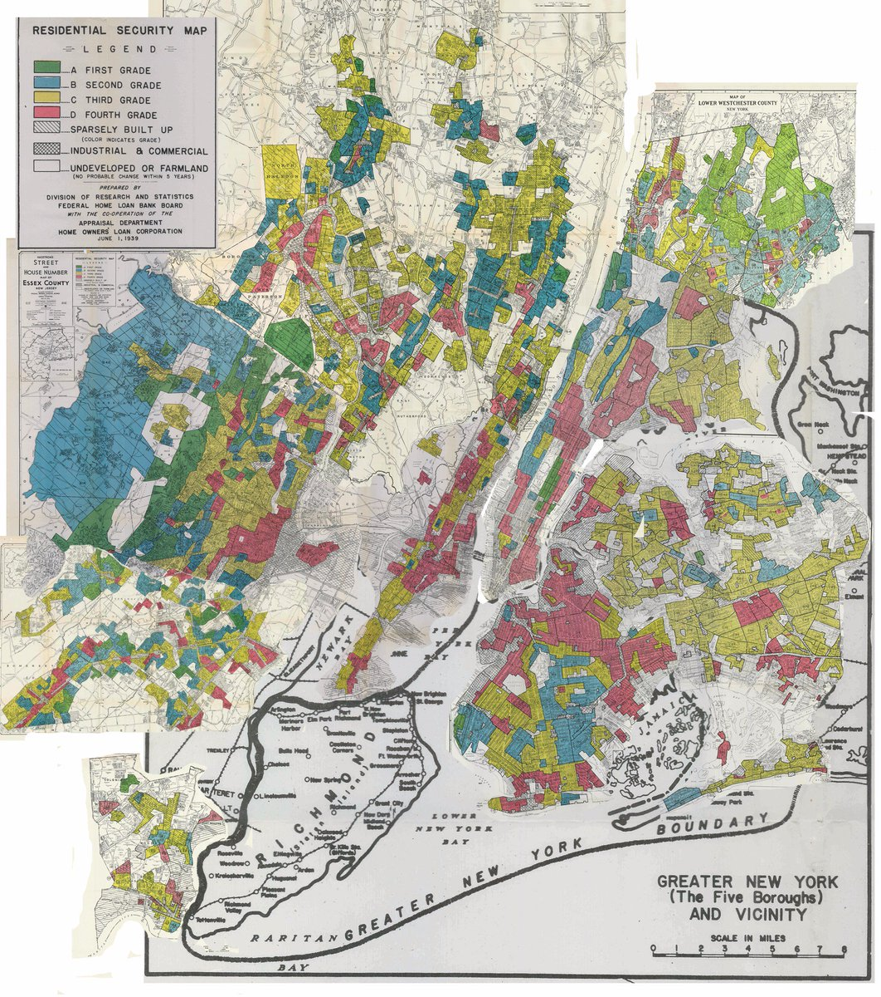
Why are we here today?
Where did these disparities come from?
From 1939, Federal Home Loan Bank Board
Notes:
https://www.google.com/url?sa=i&source=images&cd=&ved=2ahUKEwjOyr-tgpzlAhXmdd8KHbzjCREQjRx6BAgBEAQ&url=%2Furl%3Fsa%3Di%26source%3Dimages%26cd%3D%26ved%3D%26url%3Dhttps%253A%252F%252Ftwitter.com%252Fgregory8jost%252Fstatus%252F735128688828817409%26psig%3DAOvVaw0hrqOR1IBxbWIlmsnc7oK4%26ust%3D1571151553626361&psig=AOvVaw0hrqOR1IBxbWIlmsnc7oK4&ust=1571151553626361
Angie
1. Introduction to the Map: This map is a historical redlining map created by the Federal Home Loan Bank Board in 1939. The colors you see represent how different neighborhoods were graded based on perceived investment risk.”
“The map was used by the Home Owners' Loan Corporation (HOLC) to determine which areas were deemed 'safe' for investment and which were considered 'risky.' These categories heavily influenced lending policies, real estate values, and overall development patterns.”
2. Understanding the Color Coding:
- “The colors on this map are not random; they represent four distinct 'grades' assigned to neighborhoods. Let’s break down what each color means:
- Green areas were labeled 'A' or 'Best.' These were typically affluent, predominantly white neighborhoods considered highly desirable.
- Blue areas were labeled 'B' or 'Still Desirable,' indicating stable communities, but ones that might be at risk of decline.
- Yellow areas were labeled 'C' or 'Definitely Declining.' These were often neighborhoods with a mix of white, immigrant, and minority residents, perceived as less desirable and showing signs of economic stress.
- Red areas were labeled 'D' or 'Hazardous.' These neighborhoods were often predominantly African American or immigrant communities. They were considered high-risk and essentially cut off from access to mortgages and investment.”
3. What Redlining Meant for Communities:
- “Red areas, or ‘redlined’ communities, were systematically denied the same access to resources, including home loans and credit, that were available to residents in the ‘A’ or ‘B’ areas.”
- “This led to stark differences in wealth accumulation, housing stability, and community investment. For generations, families in these redlined areas were locked out of opportunities to build equity, leading to disparities in health, education, and overall economic outcomes.”
4. Impact on Health and Education:
- “The long-term impact of these policies is still visible today. Neighborhoods that were redlined often have lower home values, under-resourced schools, and fewer health services.”
- “We see higher rates of chronic illnesses, lower life expectancy, and poorer academic outcomes in these areas, even decades after redlining was banned.”
5. Linking to Our Work:
- “Understanding this history is essential because it helps explain why certain communities have higher health and educational disparities today.”
- “The neighborhoods circled in yellow are specific areas where we see these historical patterns reflected in current health data, including higher rates of asthma, obesity, and other health conditions that affect children’s ability to learn and thrive.”
6. Framing the Need for HRL:
- “Healthy and Ready to Learn’s work is rooted in addressing these deep-seated health barriers that are a legacy of structural racism and disinvestment.”
- “Our goal is to not just treat symptoms, but to understand and dismantle these barriers by integrating culturally responsive health services and creating environments where all children have a chance to succeed.”
7. Transition to Next Section:
- “So when we ask, ‘Why are we here today?’, the answer lies in understanding these historical roots and how they shape the present landscape. This context sets the stage for our work and why our intervention model is so critical.”
---

Slide 6
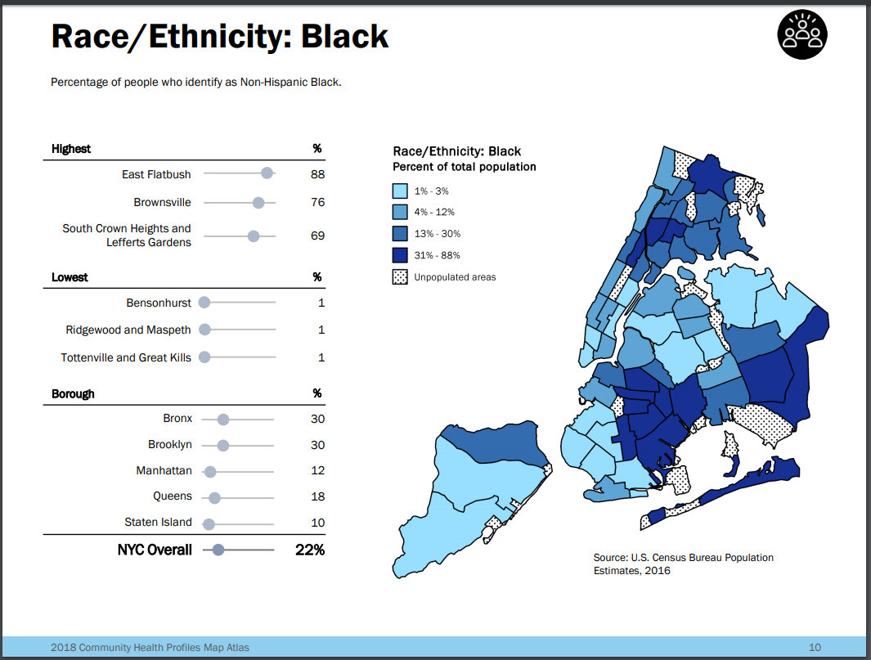
Notes:
https://www1.nyc.gov/assets/doh/downloads/pdf/data/2018-chp-atlas.pdf
Angelika
Show correlations: Highlight key neighborhoods that appear in multiple maps to drive home the point of concentrated disadvantage.
1. From Redlining Map to Race/Ethnicity Maps: Transition Sentence: “Now that we understand the historical roots of disinvestment through redlining, let’s see how these boundaries affected the demographic distribution of race and ethnicity across New York City over time.”
- Key Points:
- Highlight that the redlining map defined which groups could access wealth and which were systematically excluded.
- Explain that today, areas historically redlined still have high concentrations of Black and Latino populations, reflecting the generational impacts of these policies.
- Purpose: Set the stage for showing how these policies shaped the racial and ethnic composition of the city, which in turn influenced health, housing, and educational outcomes.

Slide 7
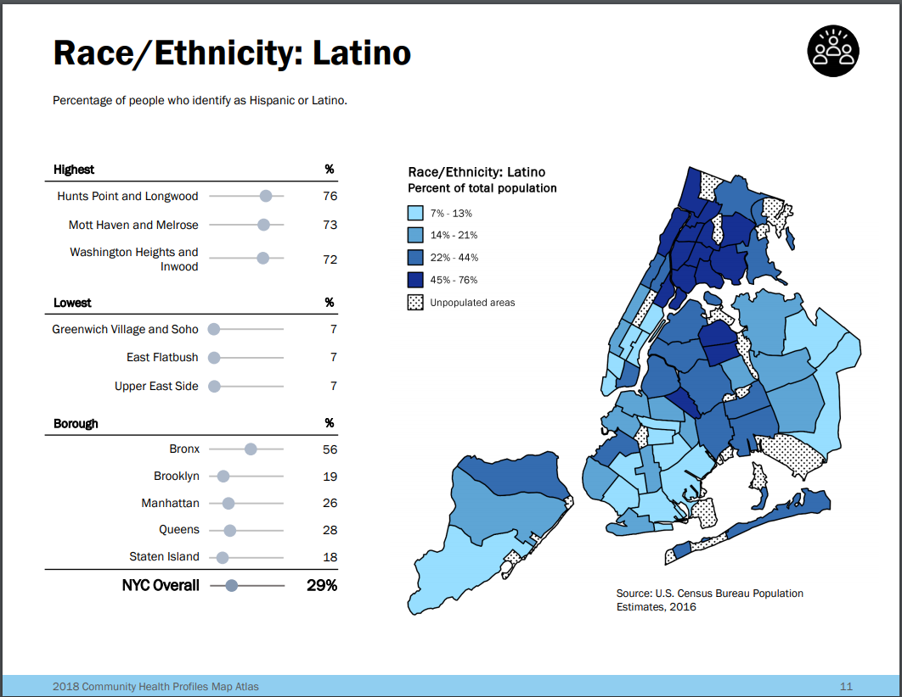
Notes:
https://www1.nyc.gov/assets/doh/downloads/pdf/data/2018-chp-atlas.pdf
Angelika
From Race/Ethnicity: Black to Race/Ethnicity: Latino:
- Transition Sentence:“Just as Black communities were concentrated in specific areas, we see similar patterns for Latino populations. Let’s explore where Latino communities have historically been and continue to reside.”
- Key Points:
- Mention how different racial and ethnic groups faced unique but interconnected barriers.
- Emphasize that despite differences, both Black and Latino communities were similarly impacted by policies of exclusion and lack of investment.
- Purpose: Draw parallels between the two maps to show overlap and distinct concentrations, reinforcing that systemic inequities targeted multiple groups.

Slide 8
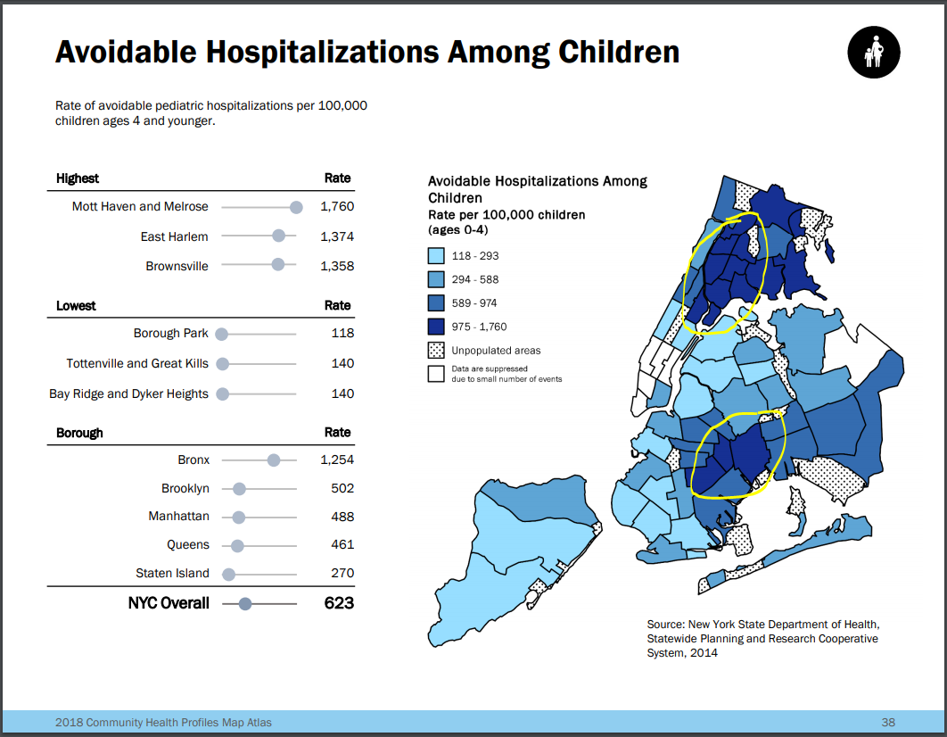
Notes:
Angelika
From Race/Ethnicity Maps to Avoidable Hospitalizations:
- Transition Sentence:
“Now, let’s look at the consequences of these demographic distributions in terms of health outcomes. We can see that the areas with high Black and Latino populations are also the ones with the highest rates of avoidable hospitalizations among children.”
- Key Points:
- Use this map to underscore the health disparities that stem from the same areas marked by redlining.
- Explain that ‘avoidable hospitalizations’ are a proxy for access to healthcare, preventive services, and overall community health.
- Purpose: This map should visually connect race/ethnicity concentrations with health outcomes, demonstrating how historical inequities manifest in current health disparities.

Slide 9
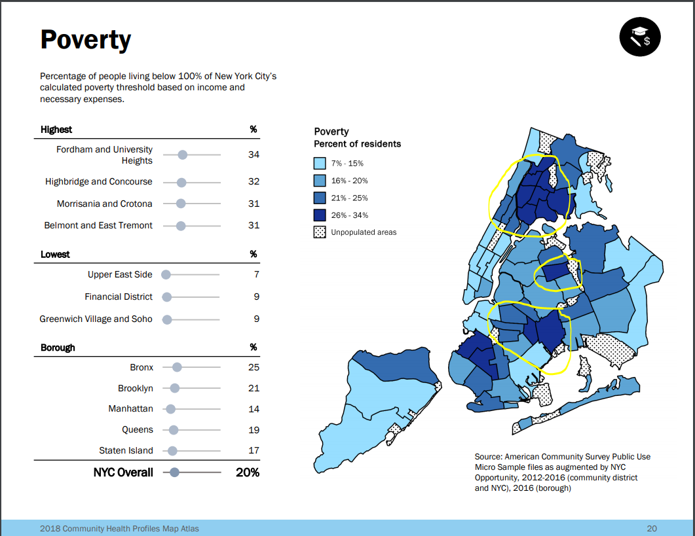
Notes:
Angelika
From Avoidable Hospitalizations to Poverty Map:
- Transition Sentence:
“Health outcomes don’t exist in a vacuum. They are deeply intertwined with socioeconomic status. If we overlay a map of poverty, we see a strong correlation between areas of high hospitalization rates and poverty levels.”
- Key Points:
- Emphasize that poverty is both a cause and consequence of poor health.
- Draw connections between the concentration of poverty and the communities with higher rates of avoidable hospitalizations.
- Purpose: This transition should deepen the understanding of the structural issues affecting health, showing how economic instability exacerbates health risks.

Slide 10
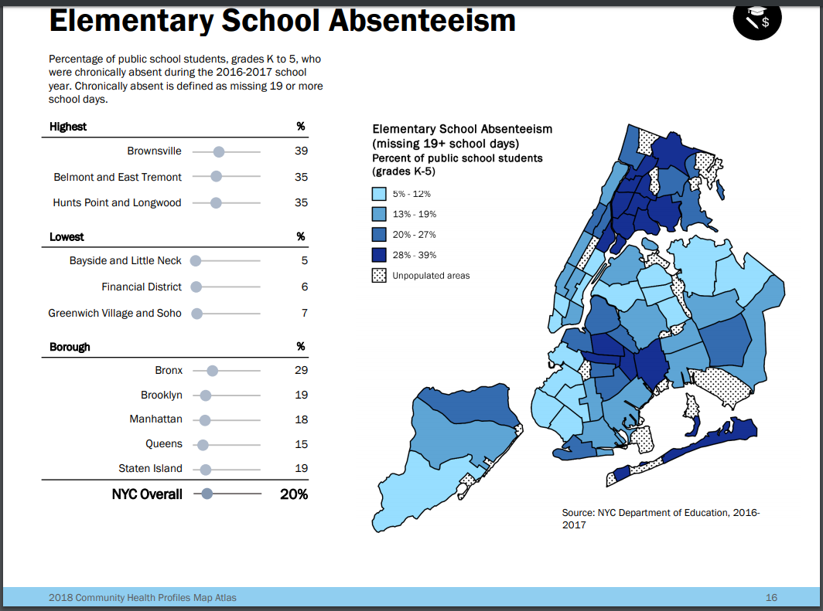
Notes:
Angelika
From Poverty to Elementary School Absenteeism:
- Transition Sentence:
“Let’s see how these economic and health challenges translate into educational outcomes. One of the most telling indicators is elementary school absenteeism, where we see that children in these high-poverty, high-health-risk areas are the ones missing the most school days.”
- Key Points:
- Explain that chronic absenteeism is often linked to health problems, lack of resources, and instability at home.
- Emphasize how missing school has a cascading effect on children’s educational achievement and long-term prospects.
- Purpose:Reinforce that health, poverty, and education are interconnected, with disparities in one area affecting outcomes in the others.

Slide 11
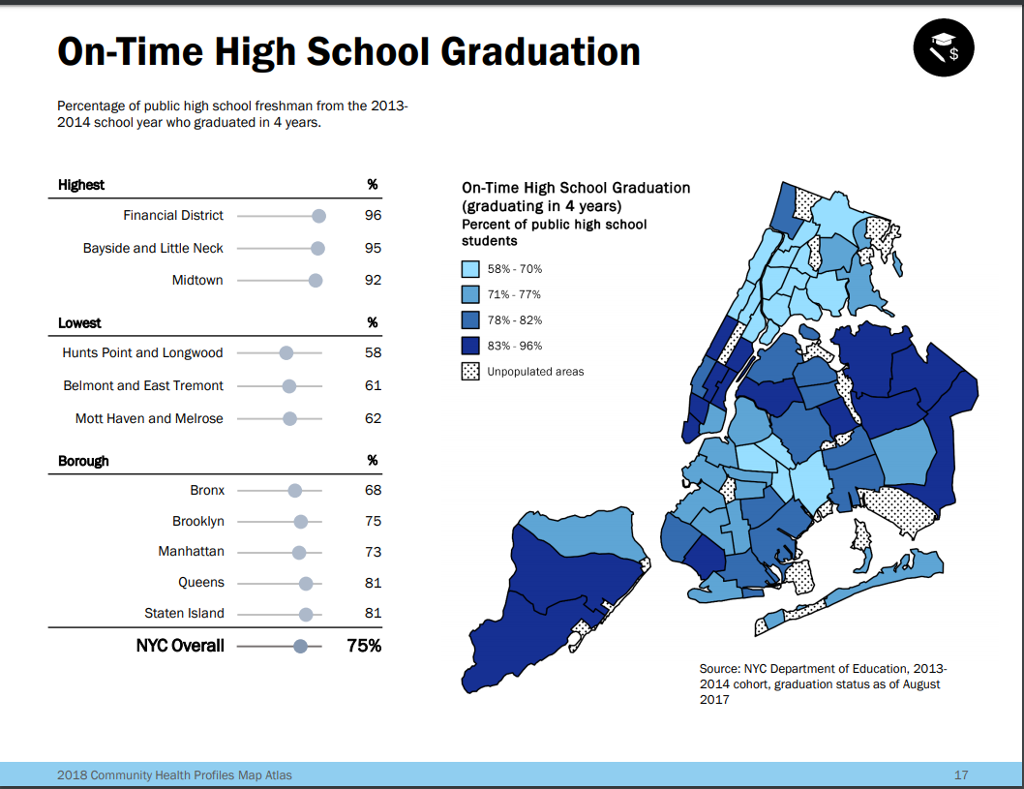
Notes:
Angelika
From Elementary School Absenteeism to High School Graduation Rates:
- Transition Sentence:
“Chronic absenteeism in elementary school is a strong predictor of poor academic outcomes later on, including lower high school graduation rates.”
- Key Points:
- Highlight that students who face multiple barriers—poor health, economic hardship, and frequent absences—are at a higher risk of dropping out or not graduating on time.
- Note that the areas with low graduation rates align with those facing the highest health and economic disparities.
- Purpose: Use this map to complete the narrative, showing the cumulative impact of systemic inequities from childhood through adolescence and into adulthood.
“What we see across all these maps is a pattern of systemic inequity that began with redlining and continues to affect health, education, and economic outcomes for these communities today. Our work is focused on breaking these cycles by addressing health barriers to learning and creating opportunities for children to thrive.”
- Key Points:
- Reiterate the historical context and connect it to the mission of Healthy and Ready to Learn.
- Conclude by affirming that HRL’s work is about addressing root causes, not just symptoms.

Slide 12
Systemic vs. What We Can Intervene
Underlying Adversities
Health Barriers
to Learning
Classroom/Learning
impact
Long-term
consequences
Poor academic
performance
Failure to meet
educational benchmarks
Chronic health issues
Increased inclination to risky behaviors
Reduced well-being
Reduced earning potential
Increased incarceration
Poverty
Racism/Racial disparities
Educational disparities
Health disparities
Toxic stress/ Trauma
Food insecurity
Housing insecurity
Vision deficits
Uncontrolled
asthma
Recurrent hunger
Persistent dental pain
Disruptive behavioral/ mental health issues
+ Elevated lead
Chronic absenteeism
Distractibility/ inability
to focus
Fatigue
Cognitive impairment
Disrupted school environment
Learning critical sensory disabilities
Notes:
Angelika
systemic vs. what we can intervene on in our level of work use as talking for slide 14 Copy and Paste on speaker notes

Slide 13
Why We Do What We Do
HRL’s mission is to ensure that all children have the opportunity to succeed in school by addressing their health and wellness needs.
Our values—collaboration, equity, empathy, and cultural relevance—guide us in supporting schools and communities.
Notes:
Angie
Transition to HRL’s mission and values. State that HRL ensures children can thrive academically by addressing health barriers. Discuss HRL’s values of collaboration, equity, and empathy, and share examples of how these values shape decision-making and community interactions.

Slide 14
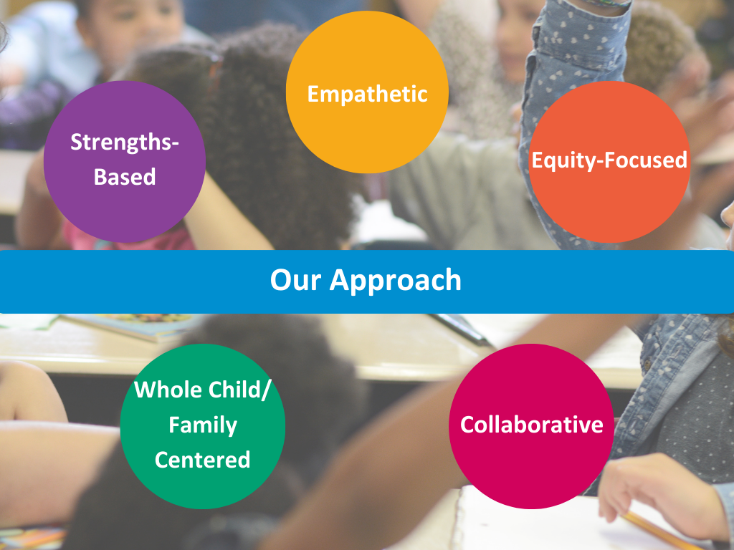
Notes:
Angie
Love and Support
Data-driven/Continuous Improvement
Cultural Relevance
Restorative Justice
Trauma-informed
Collaborative

Slide 15
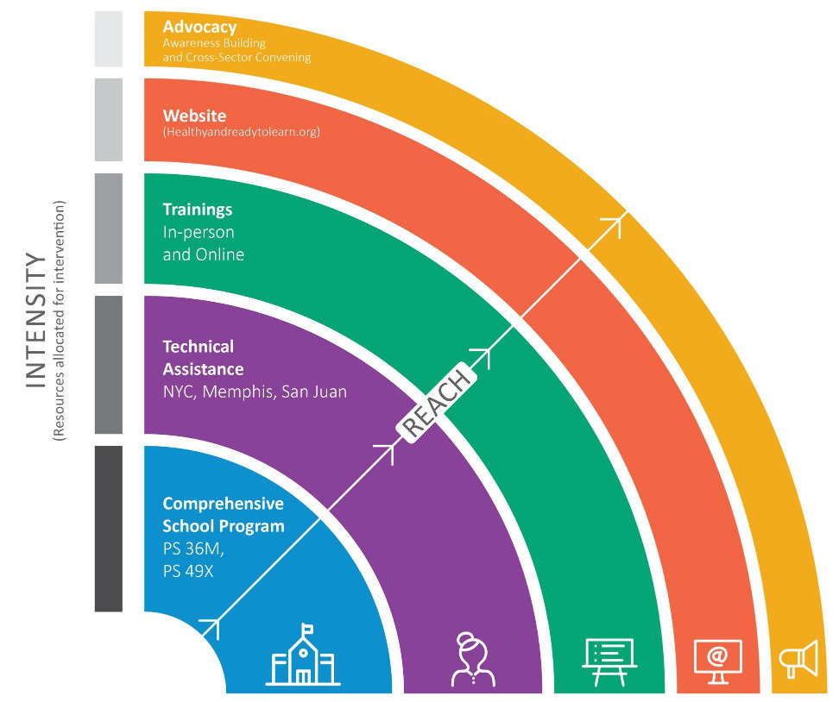
Program Alignment
Developed in 2014 to address health needs rooted in inequities that impact student learning and attendance
Flagship school programs + Technical Assistance and Resource & Training Center
Process: capacity-building, resource development & provision, knowledge/skills-based workshops for the adults in children’s lives, and community partnerships
Notes:
Angie
add speaker notes from slides 22-25 to explain the program alignment
Our approach
We strive to promote student success by increasing access to health resources, promoting trauma sensitivity, and building positive attendance culture. Beginning with school wide interventions, we apply additional strategies to increase the level of support to meet the identified level of need. Through our experience, we have gained a unique understanding of the intersection of health and education. This perspective drives our work creating resources and content that are responsive to the needs of our partners on the ground.

Slide 16
Program Overview
HRL Program Components and Interventions
HRL’s Flagship School Program, Resource and Training Center, and Technical Assistance work together to address health issues and build school capacity.
Notes:
Angie
Provide a structured breakdown of HRL’s core components: Flagship Schools, Resource and Training Center, and Technical Assistance. Use specific examples to show impact. Highlight how these components work together to create a cohesive support network for schools.

Slide 17
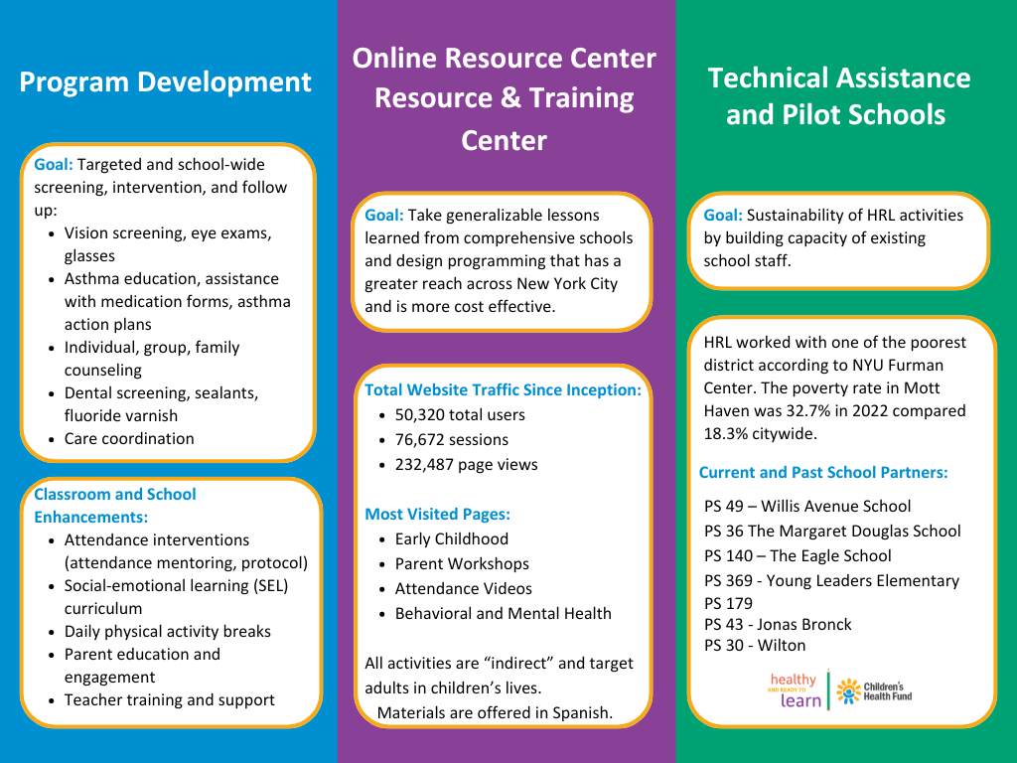
Notes:
Angie
Goal: Flagship schools
Goal: RTC
Goal: Take generalizable lessons learned from flagship schools and design programming that has a greater reach across New York City and is more cost effective.
All activities are “indirect” and target adults in children’s lives
Notes: Topics
Health Barriers to Learning
Uncontrolled Asthma
Uncorrected Vision Problems
Unaddressed Hearing Problems
Dental Pain
Persistent Hunger
Mental Health and Behavioral Problems
Effects of Lead Exposure
Attendance, Trauma-Sensitivity, Family Engagement, & Early Childhood
Target Audiences
Families
Educators
Health Providers
Content Generated
Fact Sheets
Parent Workshops
Professional Development
Videos
Infographics
Interactive Tools
Goal: Technical assistance
Goal: Sustainability of HRL activities by building capacity of existing school staff
“Middle ground” between trainings/workshops and flagship school programming
Notes:
SUPPORT AND TRAIN SCHOOL TEAMS TO PROVIDE OR CREATE REFERRALS FOR:
Vision screening, eye exams, glasses
Asthma education, assistance with medication forms, asthma action plans
Individual, group, family counseling
Dental screening, sealants, fluoride varnish
Case management and care coordination
Content Generated
Fact Sheets
Parent Workshops
Professional Development
Videos
Infographics
Interactive Tools

Slide 18
Data and Evaluation
Comprehensive school model
  Student level data focused on HBLs
  Mostly process data, some outcome s to attendance and mental health with mixed results
Trainings (professional developments, parent workshops and student workshops)
  Pre/post workshop surveys
  Data to support satisfaction, knowledge, self-efficacy and behavioral intention
Technical Assistance
  2 year evaluation compromised because of COVID-19
  Positive qualitative results around relationship building and adaptability
  Outcome data focused on behavior change and implementation of HRL activities
Notes:
Angie

Slide 19
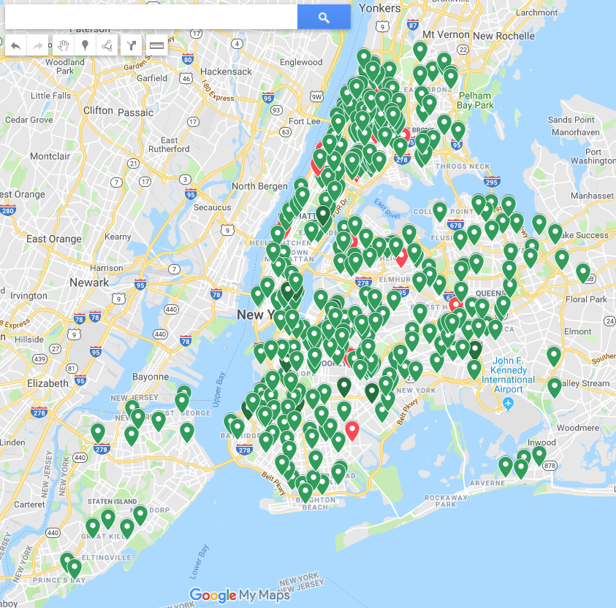
Reach
In 2023-2024 HRL trained. . .
1516 individuals including community school, daycare providers, directors, parents and others from over 23 different schools in all 5 boroughs!
Notes:
Angie

Slide 20
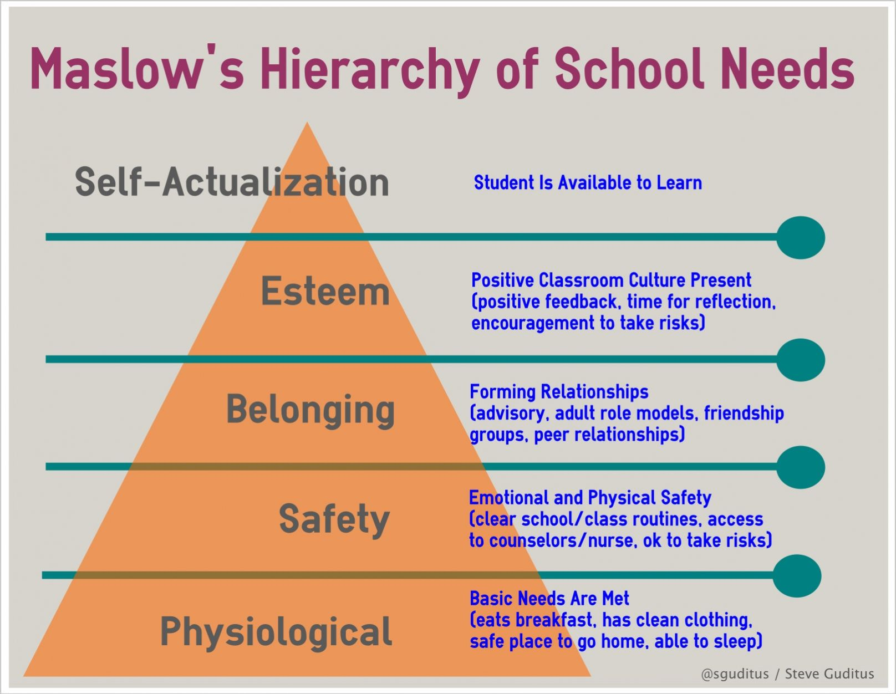
Notes:
Angelika
thinking about family priorities-- hard to have a conversation about attendance or a dentist appointment if a family is concerned with housing (physiological safety)
http://sguditus.blogspot.com/2013/02/maslows-hierarchy-of-school-needs-steve.html
Consider the barriers to accessing healthcare and asking for help (i.e. historical, competing priorities, financial, agency)
Affirm them for speaking to you and assume they want what is best for their child.
-it is a common misconception that parents do not care. Give them the benefit of the doubt.
Ask open ended questions
Listen to responses and paraphrase them back
Encourage them to ask questions
Refrain from judgement statements
Love and Support
Data-driven/Continuous Improvement
Cultural Relevance
Restorative Justice
Trauma-informed
Collaborative

Slide 21
Living Our Values
The Role of Values in Our Work
Our values impact how we show up every day. By demonstrating understanding, shared experiences, and a commitment to equity, we make meaningful connections with the communities we serve.
Notes:
Angelika
Emphasize that HRL’s values are more than words—they influence daily decisions. Share a story or quote from a team member illustrating the impact of values-driven work. Stress that success is measured by relationships built, not just numbers.

Slide 22

Redwood Metaphor
The Strength of Connection: The Redwood Trees
Just like the interconnected roots of Redwood trees, HRL’s work is interwoven with our partners and communities, providing strength and support.
Notes:
Angelika
Introduce the Redwood metaphor. Explain that interconnected roots symbolize HRL’s partnership model. Just like each tree strengthens the whole network, HRL’s partnerships and community ties create resilience and support. Reinforce that HRL’s values and approaches are woven into the fabric of its work.

Slide 23
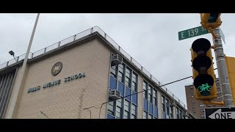
Healthy & Ready to Learn
Notes:
Angie

Slide 24
Success Through Connection
Why Shared Vision and Collaboration Matter
True success is achieved when we connect authentically with those we serve. Through shared vision and values, we create lasting impact and meaningful change.
Notes:
Angie
Conclude with a focus on authentic connections and shared values. Share a success story that embodies HRL’s impact. Emphasize that strategies matter, but lasting change comes from people and shared commitment. Leave the audience with a powerful thought on collaboration and vision.

Slide 25
Discussion Question… Q&A
How does this historical context resonate with your work or the way you see your role?
Based on this, what outcomes are important to you?
Notes:
Angelika
Conclude with a focus on authentic connections and shared values. Share a success story that embodies HRL’s impact. Emphasize that strategies matter, but lasting change comes from people and shared commitment. Leave the audience with a powerful thought on collaboration and vision.

Slide 26
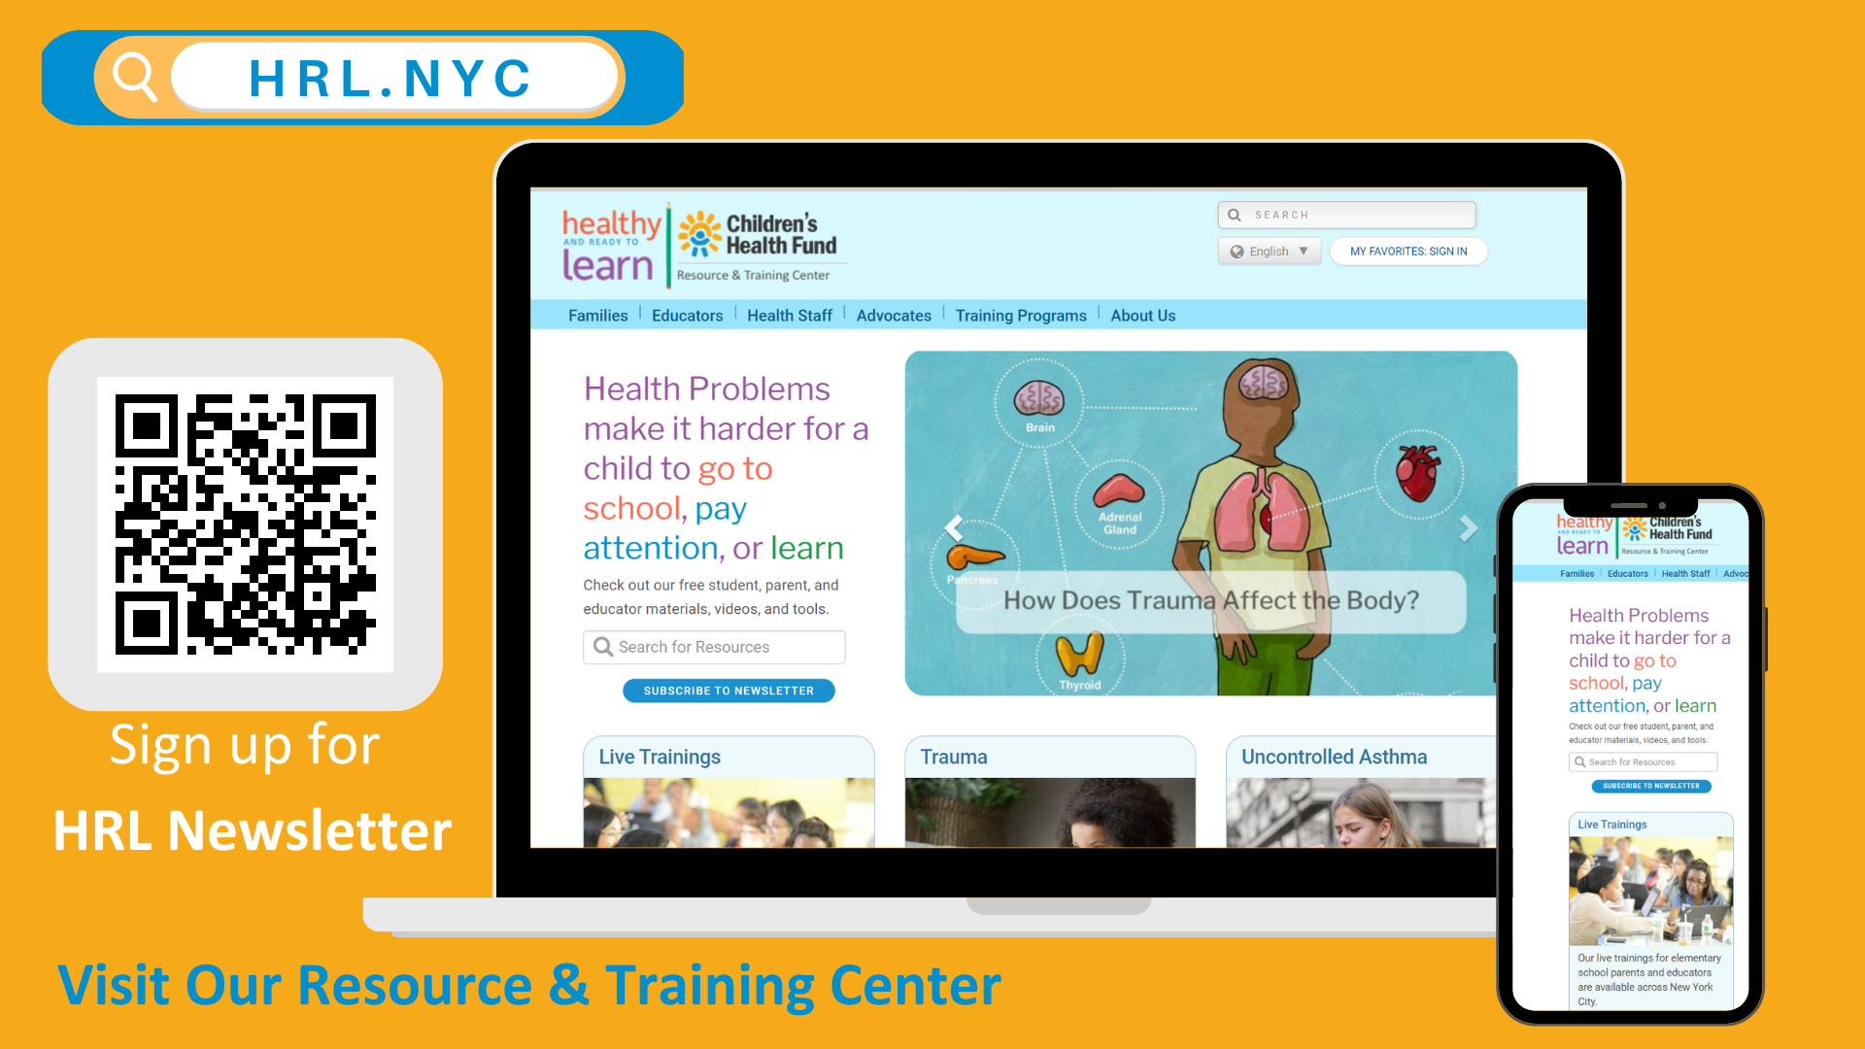
Sign up for HRL updates at hrl.nyc
Like and follow us on Social Media! @HRLNYC
Request a Training - sign up on our website or email us at rtc@chfund.org

