Slide 1
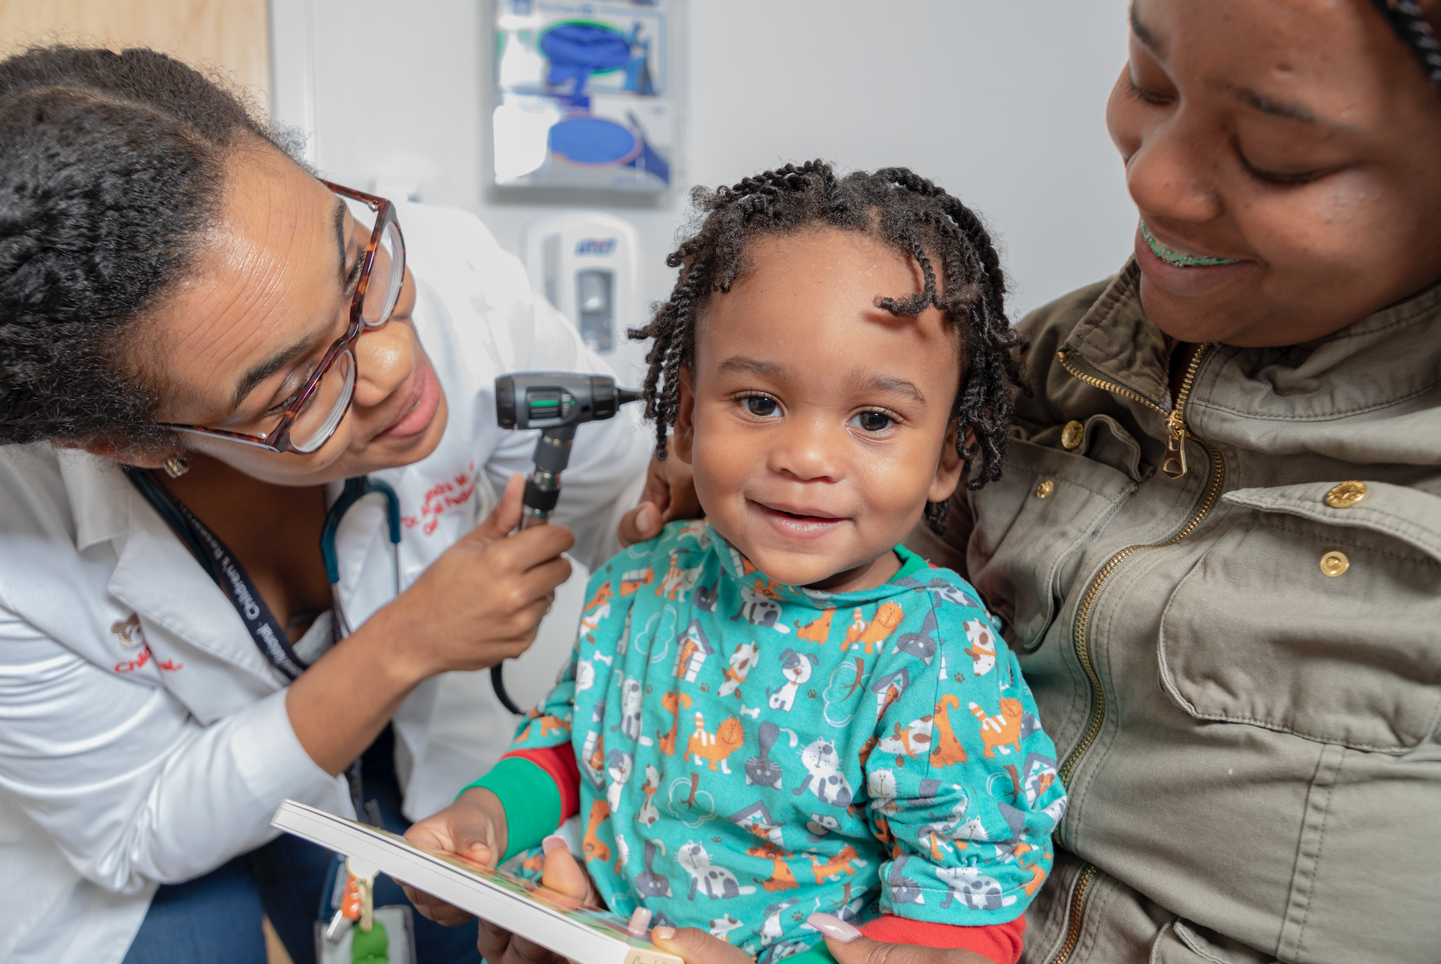


1,000,000
CHILDREN AND FAMILIES PER YEAR BY 2032
Learn more at
healthysteps.org

