Slide 1
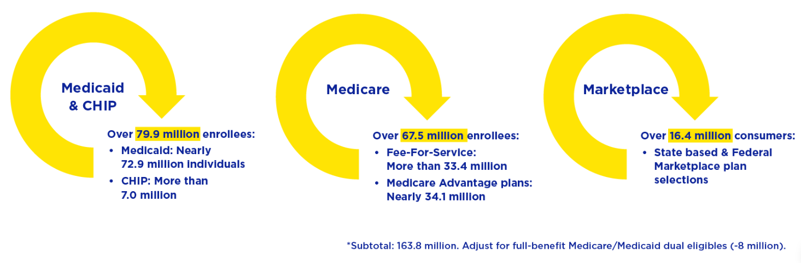
Every day, CMS ensures that 155.8 million* people in the U.S. have health coverage that works
‹#›
Source: https://www.cms.gov/pillar/expand-access as of 09/30/2024
Notes:
U.S. population increases from 342 million people in 2024 --- 45% of US population is in one of the 3Ms

Slide 2
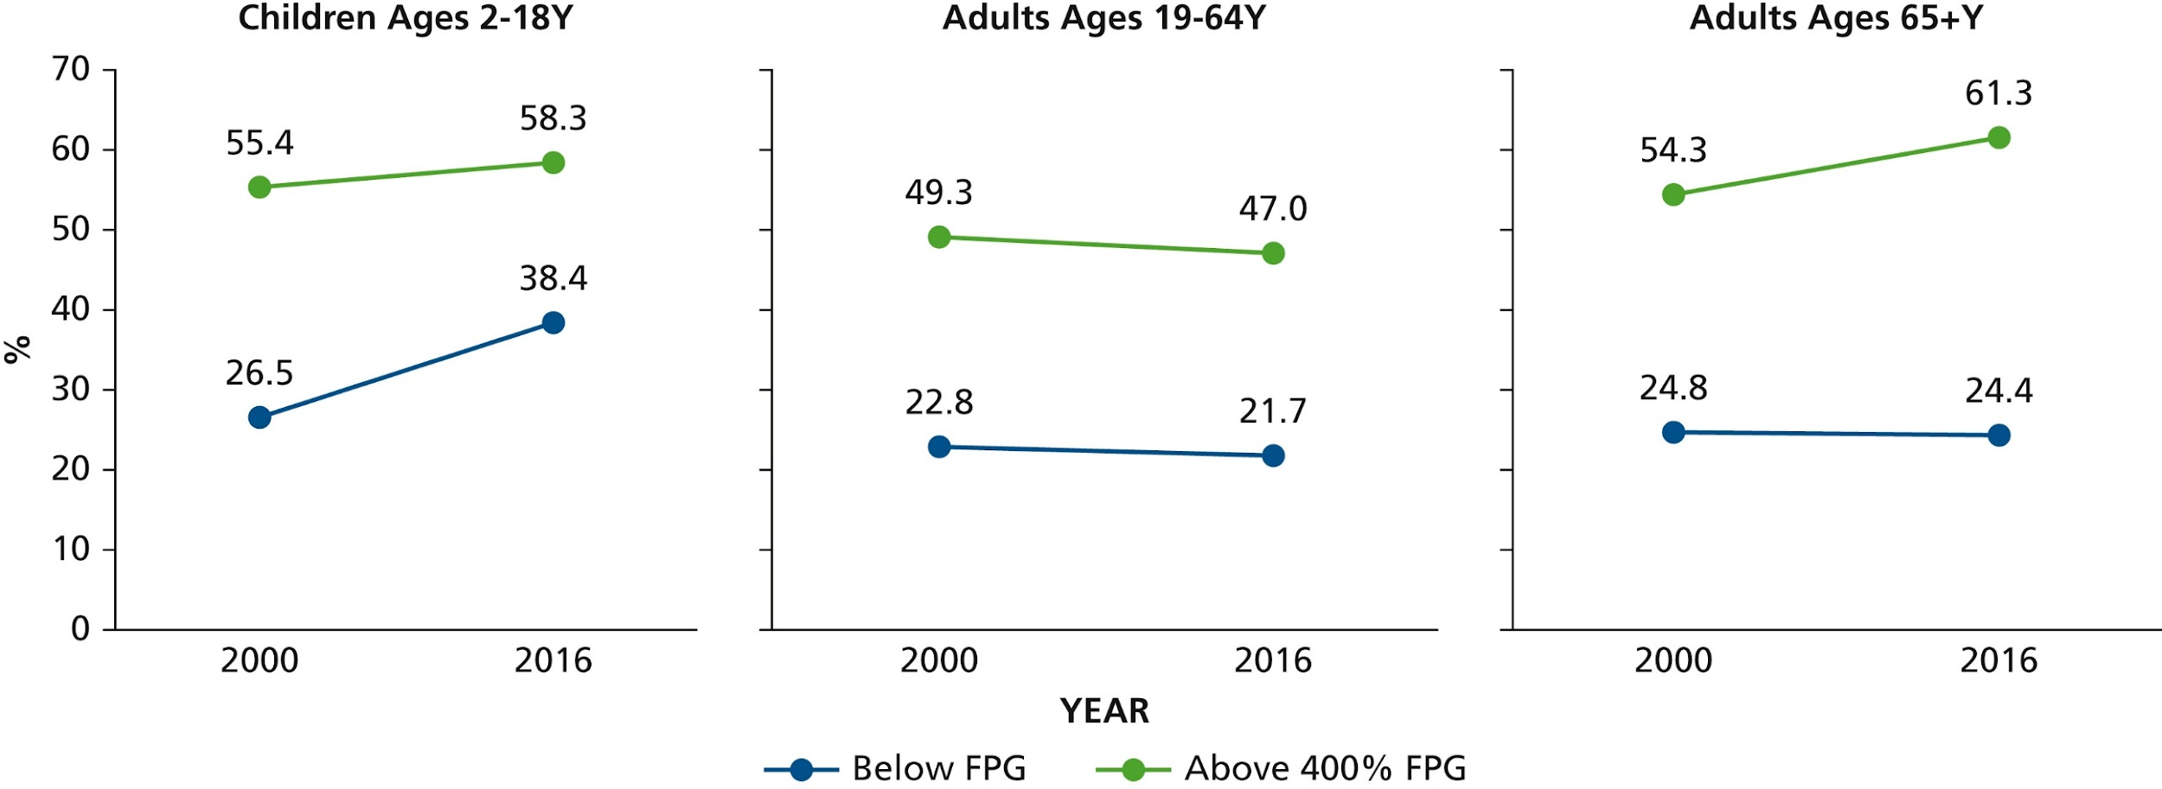
Dental Visit in the Past Year By Poverty
‹#›
Source: Yarbrough and Vujicic Oral health trends for older Americans JADA 2019
Notes:
Percentage with a dental visit to a general practitioner dentist in the past year by federal poverty guidelines (FPG), 2000 and 2016. Source: Health Policy Institute analysis of Medical Expenditure Panel Survey, 2000-2016.²
Oral health trends for older Americans
Cassandra Yarbrough, MPP, Marko Vujicic, PhD
The Journal of the American Dental Association
Volume 150 Issue 8 Pages 714-716 (August 2019)
DOI: 10.1016/j.adaj.2019.05.026

Slide 3
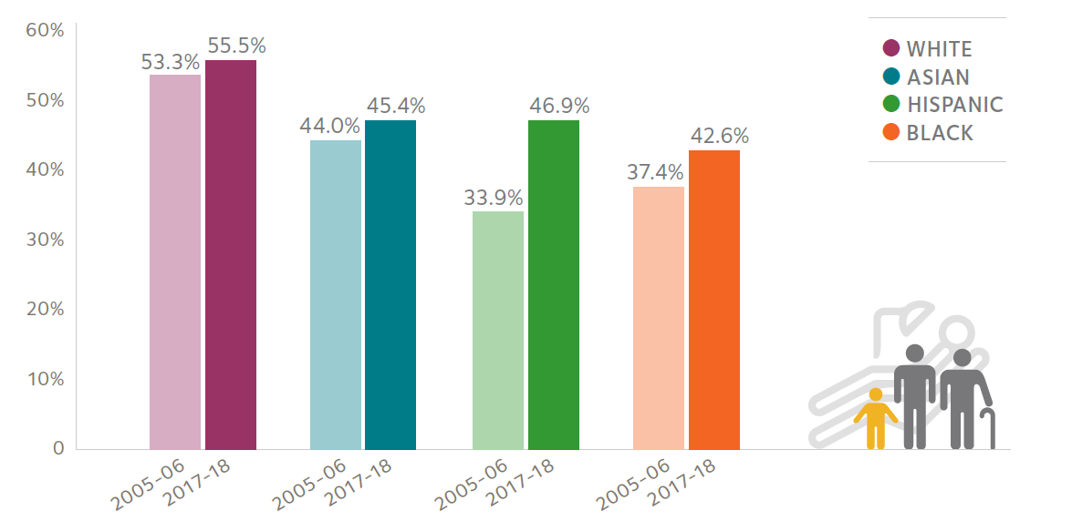
Children With A Dental Visit In The Past Year
∆ 12.9%
Proportion
‹#›
Source: ADA Health Policy Institute analysis of data from the Medical Expenditure Panel Survey
https://www.ada.org/-/media/project/ada-organization/ada/ada-org/files/resources/research/hpi/hpigraphic_0421_4.pdf
Notes:
https://www.ada.org/-/media/project/ada-organization/ada/ada-org/files/resources/research/hpi/hpigraphic_0421_4.pdf

Slide 4
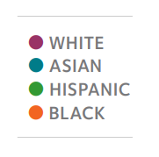
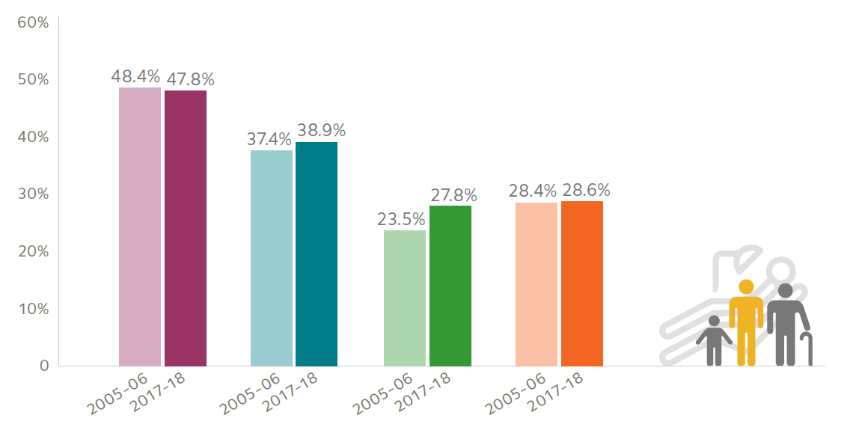
Adults With A Dental Visit In The Past Year
∆ 19.2%
Proportion
‹#›
Source: ADA Health Policy Institute analysis of data from the Medical Expenditure Panel Survey
https://www.ada.org/-/media/project/ada-organization/ada/ada-org/files/resources/research/hpi/hpigraphic_0421_4.pdf
Notes:
https://www.ada.org/-/media/project/ada-organization/ada/ada-org/files/resources/research/hpi/hpigraphic_0421_4.pdf
Data represent the percent of respondents reporting they had a dental visit within the past year.

Slide 5
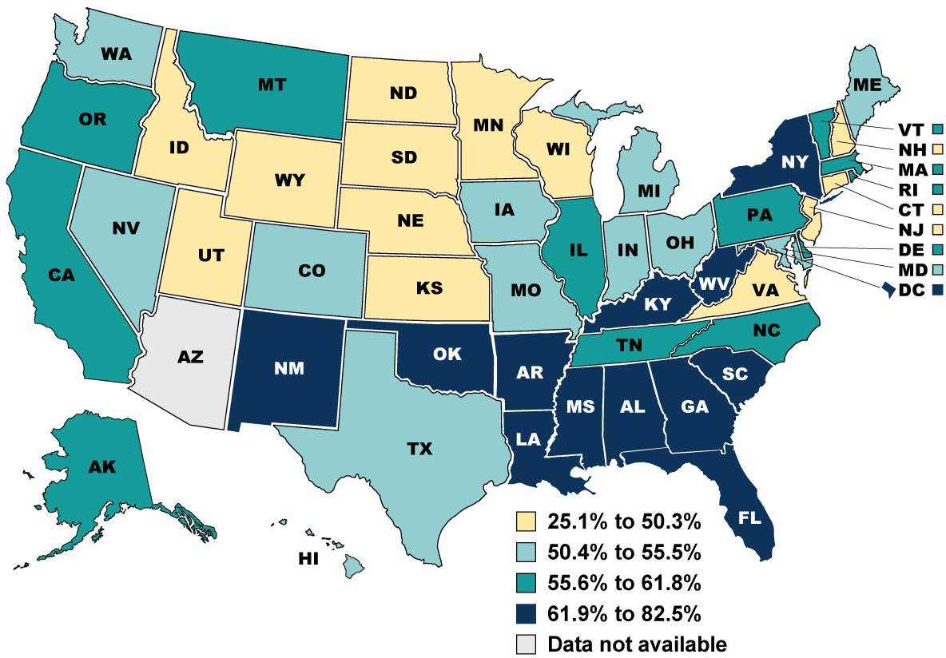
Percentage of Child Population Enrolled in Medicaid or CHIP, by State, July 2022
Notes:
Enrollment in Medicaid or CHIP includes individuals with full Medicaid or CHIP benefits and excludes individuals who are eligible only for restricted benefits, such as Medicare cost-sharing, family planning-only benefits, and emergency services-only benefits. The percentage of each state’s population enrolled in Medicaid or CHIP was calculated by dividing administrative, monthly point-in-time counts of Medicaid and CHIP child enrollment by estimates of each state’s resident population of children. Children enrolled in Medicaid or CHIP in each state include children and adolescents up to age 19. Estimates of each state’s resident population include children under age 18. AZ did not report age-specific enrollment data to CMS. Results for all other states were rounded to one decimal place, and then states were assigned to quartiles.
Sources:
CMS. Updated July 2022 Applications, Eligibility, and Enrollment Data (as of November 3, 2022).
Available at:
https://www.medicaid.gov/medicaid/program
-information/medicaid-and-chip-enrollment- data/monthly-reports/index.html
U.S. Census Bureau. Estimates of the Resident Population for July 1, 2022. Table SCPRC-EST2022-18+POP.
Available at: https://www.census.gov/data/tables/time- series/demo/popest/2020s-national- detail.html
‹#›
Source: 2023 Medicaid and CHIP Beneficiary Profile, https://www.medicaid.gov/medicaid/quality-of-care/downloads/beneficiary-profile-2023.pdf

Slide 6
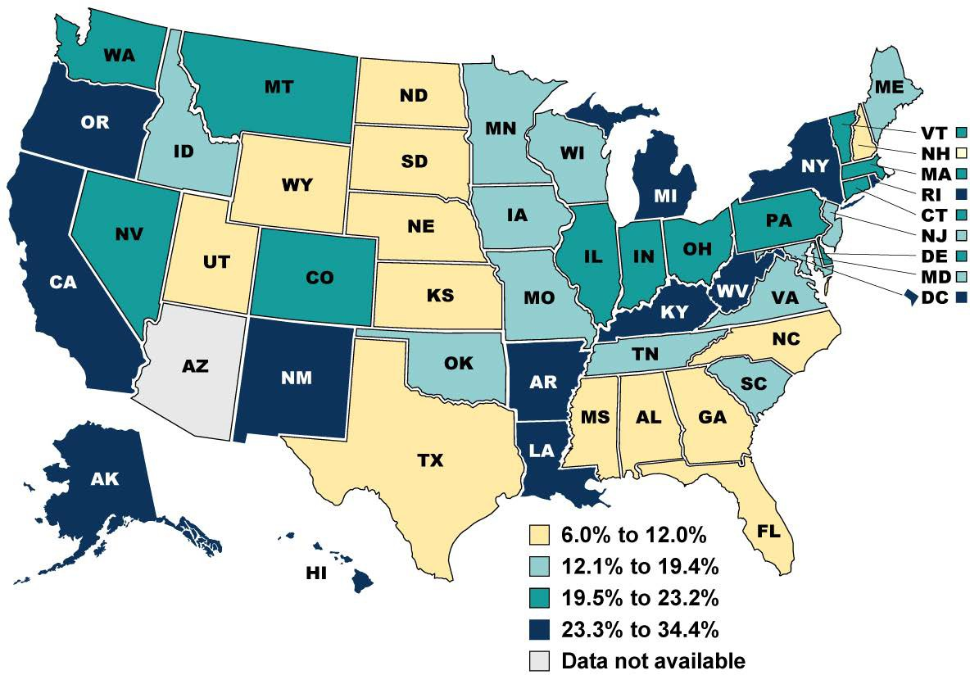
Percentage of Adult Population Enrolled in Medicaid or CHIP, by State, July 2022
Notes:
Enrollment in Medicaid or CHIP includes individuals with for full Medicaid or CHIP benefits and excludes individuals who are eligible only for restricted benefits, such as Medicare cost-sharing, family planning-only benefits, and emergency services-only benefits. The percentage of each state’s population enrolled in Medicaid or CHIP was calculated by dividing administrative, monthly point-in-time counts of Medicaid and CHIP adult enrollment by estimates of each state’s resident population of adults.
Adults enrolled in Medicaid or CHIP in each state include adults and seniors age 19 and older. Estimates of each state’s resident population include adults age 18 and over. AZ did not report age-specific enrollment data to CMS. Results for all other states were rounded to one decimal place, and then states were assigned to quartiles.
Sources:
CMS. Updated July 2022 Applications, Eligibility, and Enrollment Data (as of November 3, 2022).
Available at:
https://www.medicaid.gov/medicaid/program
-information/medicaid-and-chip-enrollment- data/monthly-reports/index.html
U.S. Census Bureau. Estimates of the Resident Population for July 1, 2022. Table SCPRC-EST2022-18+POP.
Available at: https://www.census.gov/data/tables/time- series/demo/popest/2020s-national- detail.html
‹#›
Source: 2023 Medicaid and CHIP Beneficiary Profile, https://www.medicaid.gov/medicaid/quality-of-care/downloads/beneficiary-profile-2023.pdf

Slide 7


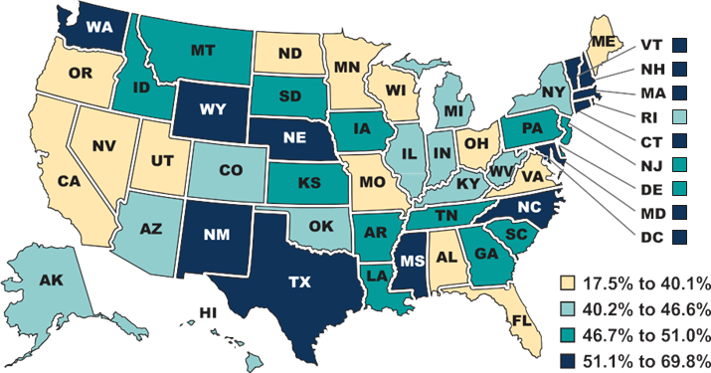









Children and Adolescents Who Received Oral Examinations or Topical Fluoride Treatments, 2018
Beneficiaries with at Least One Oral Examination
‹#›
Source: 2023 Medicaid and CHIP Beneficiary Profile https://www.medicaid.gov/medicaid/quality-of-care/index.html
Notes:
Notes:
Oral examinations are defined according to logic adapted from the 2021 Oral Evaluation, Dental Services (OEV-CH-A) measure in the Dental Quality Alliance (DQA) Pediatric Measure Set. Due to concerns with the quality of Provider Taxonomy information in T-MSIS analytic files (TAF), this exhibit does not require the service be rendered by or under the supervision of a dentist and instead counts all services billed with a Current Dental Terminology (CDT) code indicating an oral examination (D0120, D0145, D0150).
Topical fluoride treatments are defined according to logic adapted from the 2021 Prevention: Topical Fluoride for Children at Elevated Caries Risk, Dental or Oral Health Services (TFL-CH-A(D/OH)) measure in the DQA Pediatric Measure Set, which identifies services with CDT codes D1206 and D1208. Topical fluoride treatments also include services with the Current Procedural Terminology (CPT) code 99188 for fluoride varnish application. This exhibit does not require the service be rendered by or under the supervision of a dentist and instead counts all services billed with a CDT or CPT code indicating a fluoride treatment. Totals may not sum to 100% due to rounding.

Slide 8











Where Patients Present with Oral Health Needs
Ambulatory Surgery
Emergency Department
Inpatient Admission
Urgent
Clinic
Health Information Technology Divide
Diagnostic Coding
Integration and Coordination of Care
‹#›

Slide 9





Where People Manage Oral Health
8760 hours
in a year
8758 h
2 h
People spend more hours managing their oral health at home than in a clinical setting.
‹#›

Slide 10
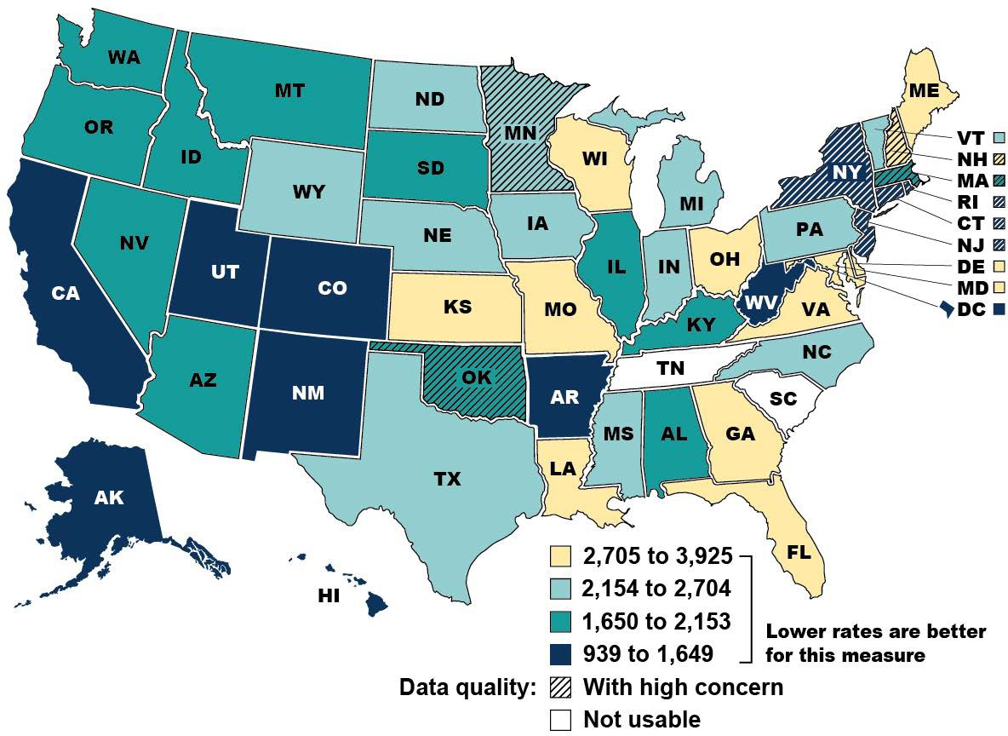
Emergency Department Visits for Non-Traumatic Dental Conditions per 100,000 Adult Beneficiaries, by State, 2019
Population: Medicaid and CHIP beneficiaries ages 21 to 64 with full Medicaid or CHIP benefits and not dually eligible for Medicare
Notes:
Non-traumatic dental conditions (NTDCs) are dental conditions such as cavities or dental abscesses that might have been prevented with regular dental care.
Emergency Department (ED) visits for NTDCs may indicate a lack of access to more appropriate sources of medical and dental care. CMS assessed state-level data quality in the 2019 TAF file using the following metrics: total enrollment, inpatient (IP) and other services (OT) claims volume; completeness of diagnosis code (IP file); completeness of procedure code (OT and IP files); and expected type of bill code (IP file). States with an unusable data quality assessment (TN, SC) are shown in white.
Results for remaining states were rounded to whole numbers, and then states were assigned to quartiles. States with a high concern data quality assessment are shown with a hatched overlay. For additional information regarding state variability in data quality, please refer to the Medicaid DQ Atlas, available at: https://www.medicaid.gov/dq-atlas/welcome.
Source:
CMS analysis of calendar year 2019 T-MSIS Analytic Files, v 5.0.
Additional information available at: https://www.medicaid.gov/medicaid/benefits/ downloads/adult-non-trauma-dental-ed
-visits.pdf and https://www.medicaid.gov/medicaid/benefits/ dental-care/index.html
‹#›
Source: https://www.medicaid.gov/medicaid/quality-of-care/downloads/beneficiary-profile-2022.pdf

Slide 11

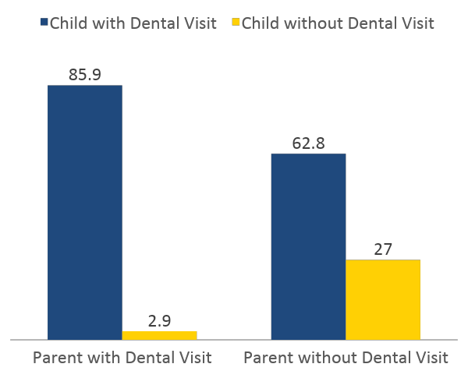
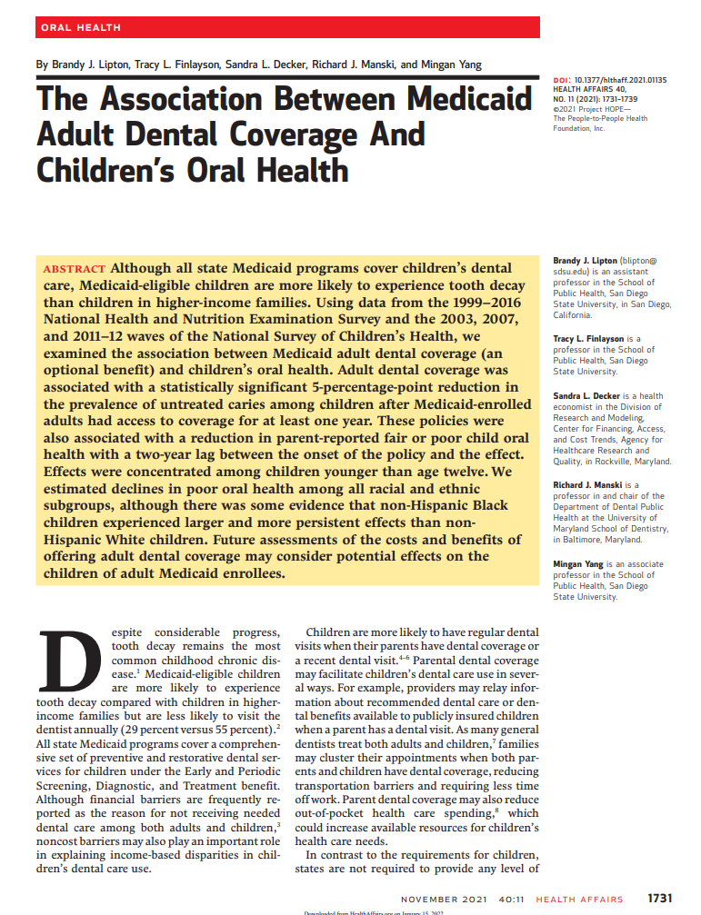
Parents Dental Care Experience is Key to Coverage and Access
Proportion
‹#›
Source: Isong et al. Pediatrics 2010
Source: Lipton et al. Health Affairs 2021
Notes:
Children were more likely to have a dental visit when their parents also had a dental visit (adjusted odds ratio: 3.36) compared with children of parents who did not have a dental visit. Children of parents who deferred their dental care because of cost were more likely to have care deferred because of cost as well (adjusted odds ratio: 12.47).
https://pediatrics.aappublications.org/content/pediatrics/125/3/502.full.pdf
Association Between Parents' and Children's Use of Oral Health Services
Inyang A. Isong, Katharine E. Zuckerman, Sowmya R. Rao, Karen A. Kuhlthau, Jonathan P. Winickoff, James M. Perrin
Pediatrics Mar 2010, 125 (3) 502-508; DOI: 10.1542/peds.2009-1417

Slide 12
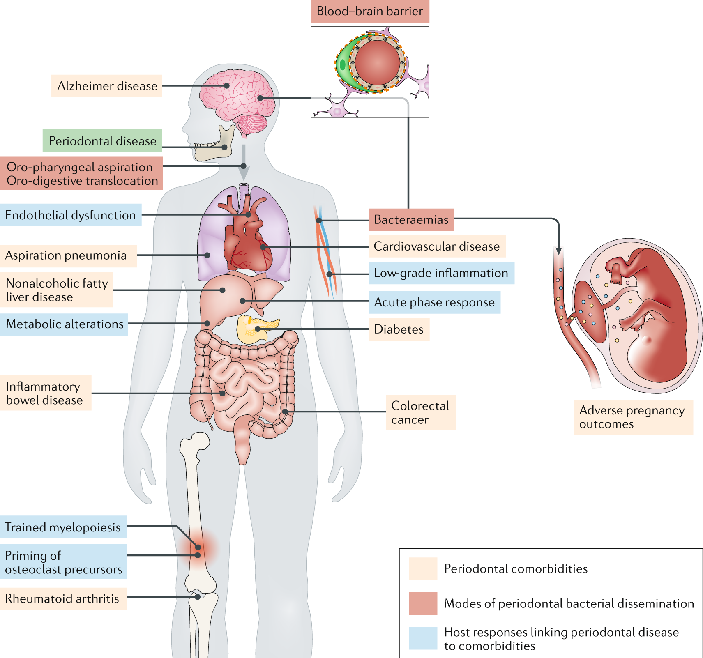
Periodontal Disease and Associated Inflammatory Comorbidities
Periodontitis Inflammatory Comorbidities
Cardiovascular disease
Type 2 diabetes mellitus
Rheumatoid arthritis
Inflammatory bowel disease
Alzheimer disease
Nonalcoholic fatty liver disease
Cancers
Dissemination
Bacteremia, hematogenous
Oro-pharyngeal dissemination
Oro-digestive dissemination
‹#›
Source: Hajishengallis and Chavakis Nat Rev Immunol 2021
Notes:
Periodontitis is a chronic inflammatory disease that progressively affects the integrity of the tissues supporting the teeth (Box 1) and is associated epidemiologically with several chronic disorders, such as cardiovascular disease, type 2 diabetes mellitus (T2DM), rheumatoid arthritis,
inflammatory bowel disease (IBD), Alzheimer disease, nonalcoholic fatty liver disease and certain cancers
On the basis of epidemiological, clinical intervention and animal model-based studies, periodontitis has been linked with a number of comorbid conditions, such as those indicated. Mechanistically, periodontitis is associated with bacteraemias and systemic inflammation, which can induce acute-phase responses as well as metabolic and inflammatory alterations in the liver and bone marrow, activities that can influence comorbid conditions. Moreover, periodontal bacteria can disseminate by different routes — haematogenous, oro-pharyngeal and oro-digestive — to reach extra-oral sites where they can cause or exacerbate inflammatory pathologies.
Hajishengallis, G., Chavakis, T. Local and systemic mechanisms linking periodontal disease and inflammatory comorbidities. Nat Rev Immunol 21, 426–440 (2021). https://doi.org/10.1038/s41577-020-00488-6

Slide 13


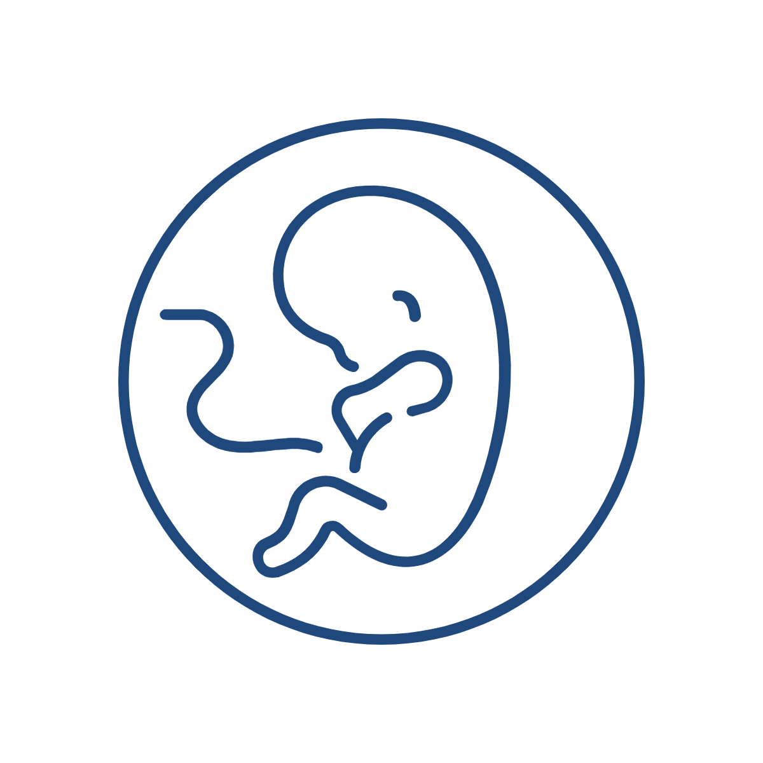

Association Between Maternal Periodontal Disease and Adverse Pregnancy Outcomes
Maternal periodontal disease increases the odds of low birthweight by
10%
Maternal periodontal disease increases the odds of preterm birth by
15%
Maternal periodontal disease increases the odds of spontaneous abortion by
34%
Maternal periodontitis increases the odds of any maternal complications by
19%
‹#›
Source: Choi et al. Family Practice, 2021
Notes:
Sung Eun Choi, Abhishek Choudhary, John M Ahern, Nathan Palmer, Jane R Barrow, Association between maternal periodontal disease and adverse pregnancy outcomes: an analysis of claims data, Family Practice, 2021;, cm
LBW (birthweight < 2500 g)
PTB (spontaneous or preterm labor or premature rupture of membrane);
pregnancies resulting in spontaneous abortions/failed labor; (iv) any of the three aforementioned adverse pregnancy outcomes.
ab037, https://doi.org/10.1093/fampra/cmab037
Key Messages
• Maternal periodontal disease increases the odds of low birthweight by 10%.
• Maternal periodontal disease increases the odds of preterm birth by 15%.
• Maternal periodontal disease increases the odds of spontaneous abortion by 34%.
• Maternal periodontitis increases the odds of any maternal complications by 19%.

Slide 14
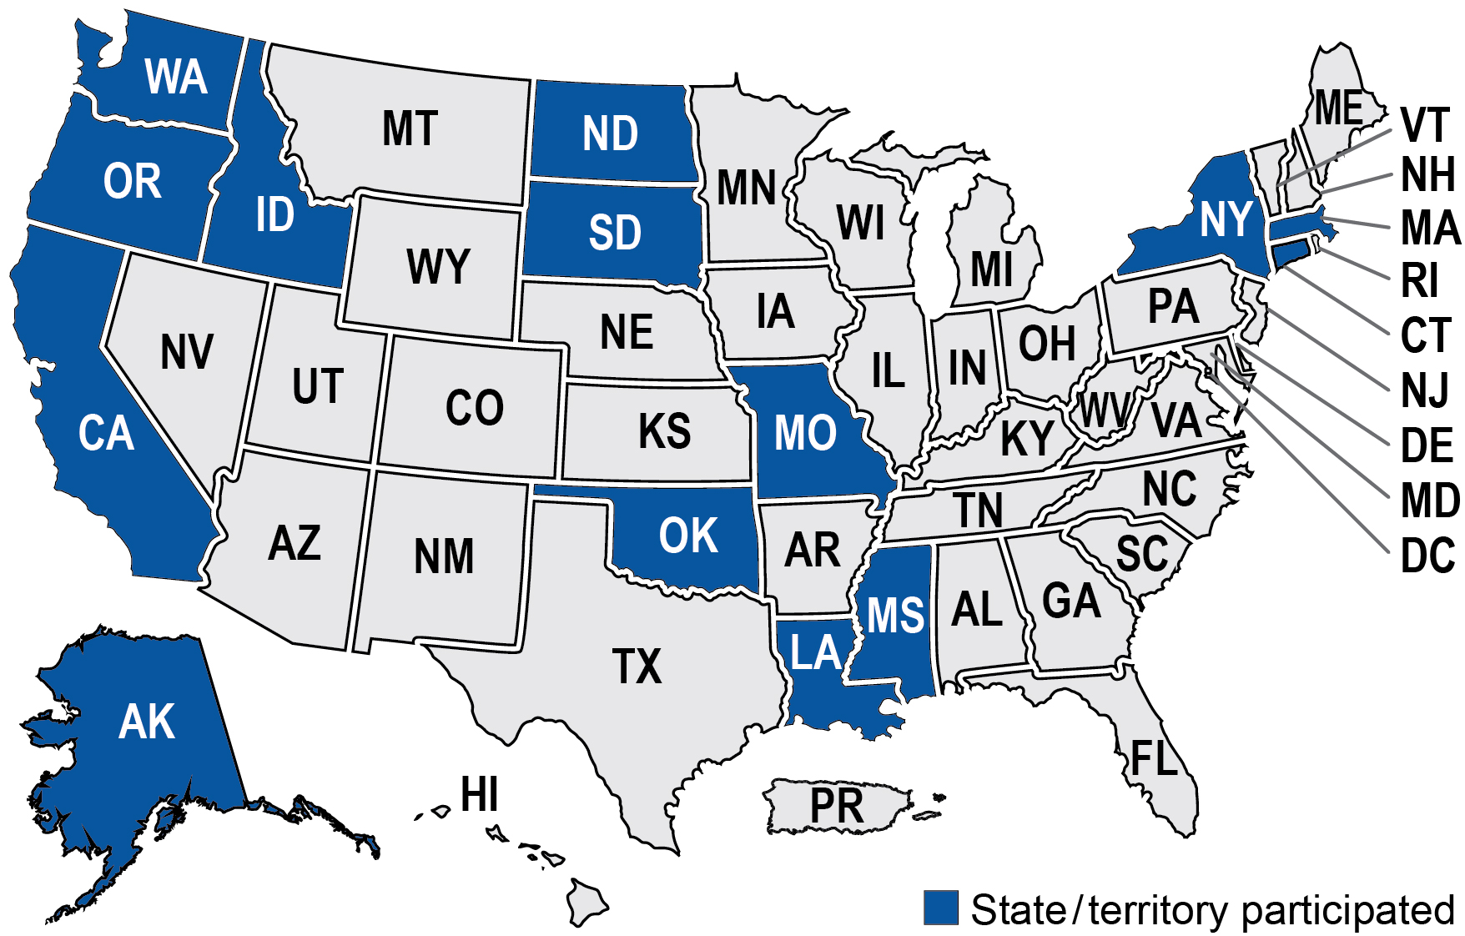
Advancing Oral Health Prevention in Primary Care
Affinity Group Map
14 States participated in the Affinity Group from February 2021 – March 2023
A principal objective of the affinity group was to support states in developing sustainable solutions for improving the delivery of FV by PCPs for children enrolled in Medicaid and CHIP. CMS supported state teams in conducting quality improvement (QI) projects and facilitated peer-to-peer learning and sharing of promising practices across states.
Many teams used the Topical Fluoride for Children (TFL-CH) measure to monitor changes in the delivery of fluoride varnish.
Topical Fluoride for Children (TFL-CH) The TFL-CH quality measure assesses the percentage of enrolled children ages 1 through 20 who received at least two topical fluoride applications within the measurement year. The Dental Quality Alliance (DQA) is the measure steward. The measure was added to the Medicaid and CHIP Child Core Set in 2022.
‹#›
Source: Highlights from the Advancing Oral Health Prevention in Primary Care Affinity Group
https://www.medicaid.gov/sites/default/files/2024-01/oral-health-highlights-brief-jan2024.pdf

Slide 15
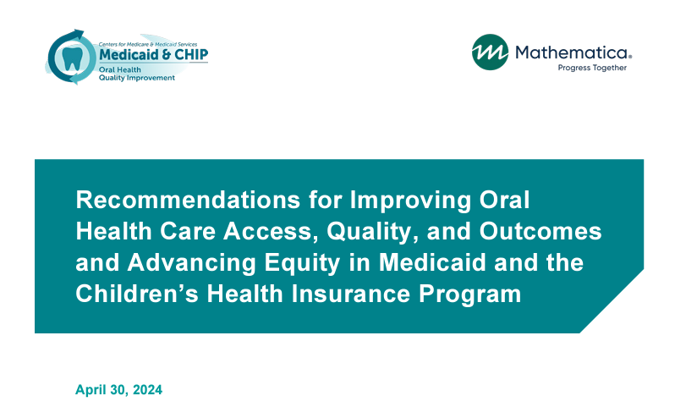
‹#›
Source: https://www.medicaid.gov/media/176321

Slide 16
Focus Areas Recommended by the Oral Health Initiative Workgroup
Focus Area 1: Increase emphasis on preventive, minimally invasive, and timely care. Within this focus area, the Workgroup identified four strategic priorities:
  Improve coordination and integration of care to increase utilization of recommended care
  Improve oral health care for pregnant and postpartum people
  Improve oral health care for adults with intellectual and developmental disabilities
  Reduce avoidable emergency department utilization for dental needs
Focus Area 2: Enhance managed care plan engagement and accountability. Within this focus area, the Workgroup identified three strategic priorities:
  Build capacity for using managed care quality tools such as the Quality Strategy (QS), Quality Assessment and Performance Improvement (QAPI), and External Quality Review (EQR)
  Identify and share best practices for care coordination in managed care settings
  Increase managed care accountability for providing high-value, high-quality care
Focus Area 3: Enhance capacity for quality measurement and analytics to track progress toward the primary aim.
‹#›
Source: https://www.medicaid.gov/media/176321

Slide 17
Social Drivers of Health and Health-Related Social Needs
Social drivers of health (SDOH): The conditions in the environments where people are born, live, learn, work, play, worship, and age that affect a wide range of health, functioning, and quality-of-life outcomes and risks. SDOH refers to community-level factors. They are sometimes called “social determinants of health.” (Adapted from CDC Healthy People 2030)
Health-related social needs: Social and economic needs that individuals experience that affect their ability to maintain their health and well-being. They put individuals at risk for worse health outcomes and increased health care use. HRSN refers to individual-level factors such as financial instability, lack of access to healthy food, lack of access to affordable and stable housing and utilities, lack of access to health care, and lack of access to transportation. (Adapted from HHS)
Health disparities: Preventable differences in the burden of disease, injury, violence, or opportunities to achieve optimal health, health quality, or health outcomes experienced by disadvantaged populations. (Adapted from CDC)
Health equity: The attainment of the highest level of health achievable for all people, where everyone has a fair and just opportunity to attain their optimal health regardless of race, ethnicity, disability, sexual orientation, gender identity, socioeconomic status, geography, preferred language, or other factors that affect access to care and health outcomes. (CMS)
‹#›
Source: https://www.cms.gov/priorities/innovation/key-concepts/social-drivers-health-and-health-related-social-needs

Slide 18
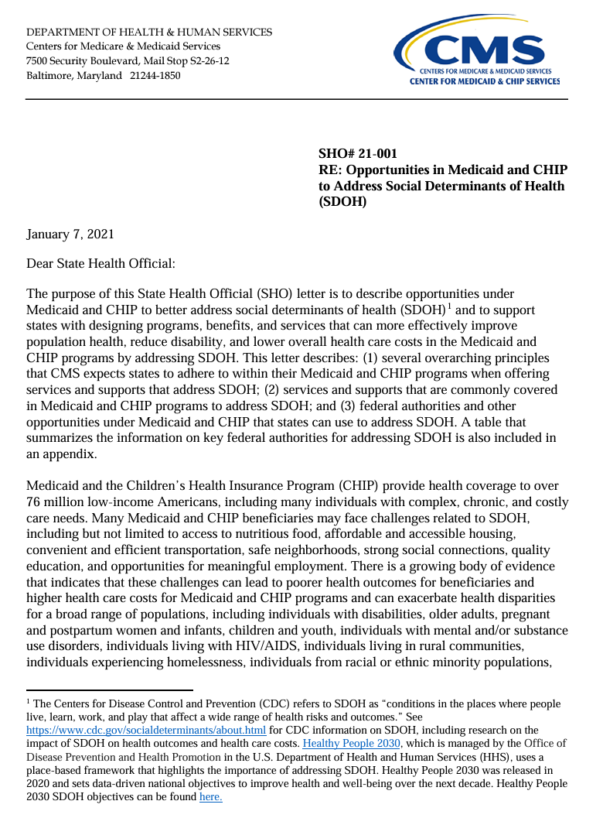
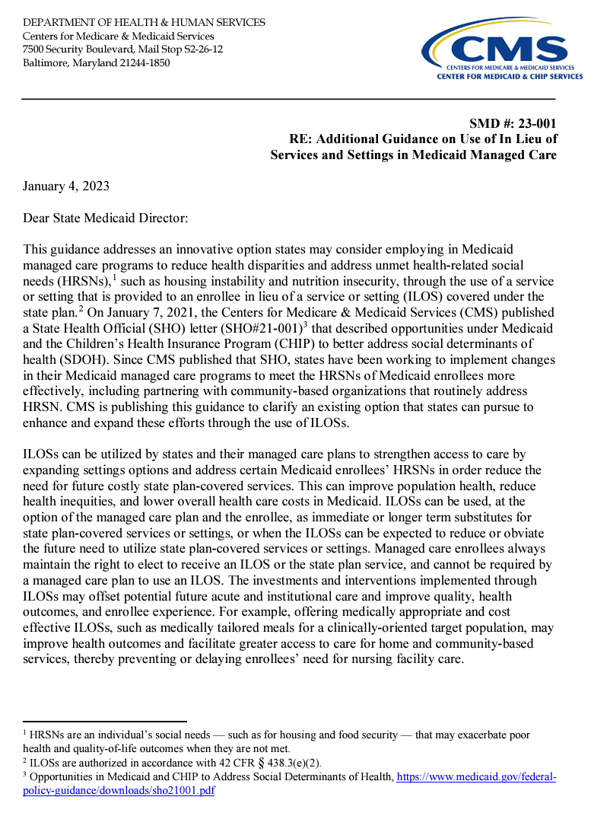
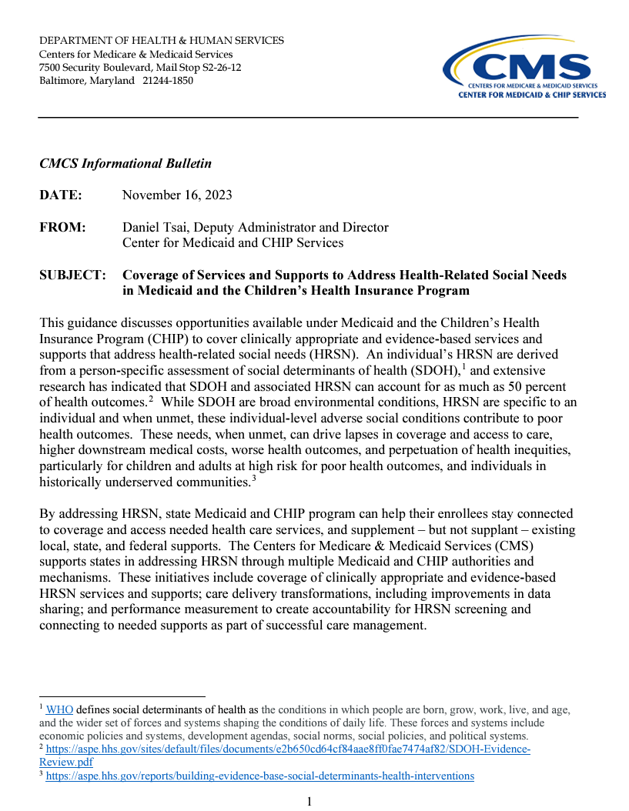
Social Drivers of Health and Health-Related Social Needs
https://www.medicaid.gov/federal-policy-guidance/downloads/sho21001.pdf
https://www.medicaid.gov/federal-policy-guidance/downloads/smd23001.pdf
https://www.medicaid.gov/federal-policy-guidance/downloads/cib11162023.pdf
‹#›

Slide 19
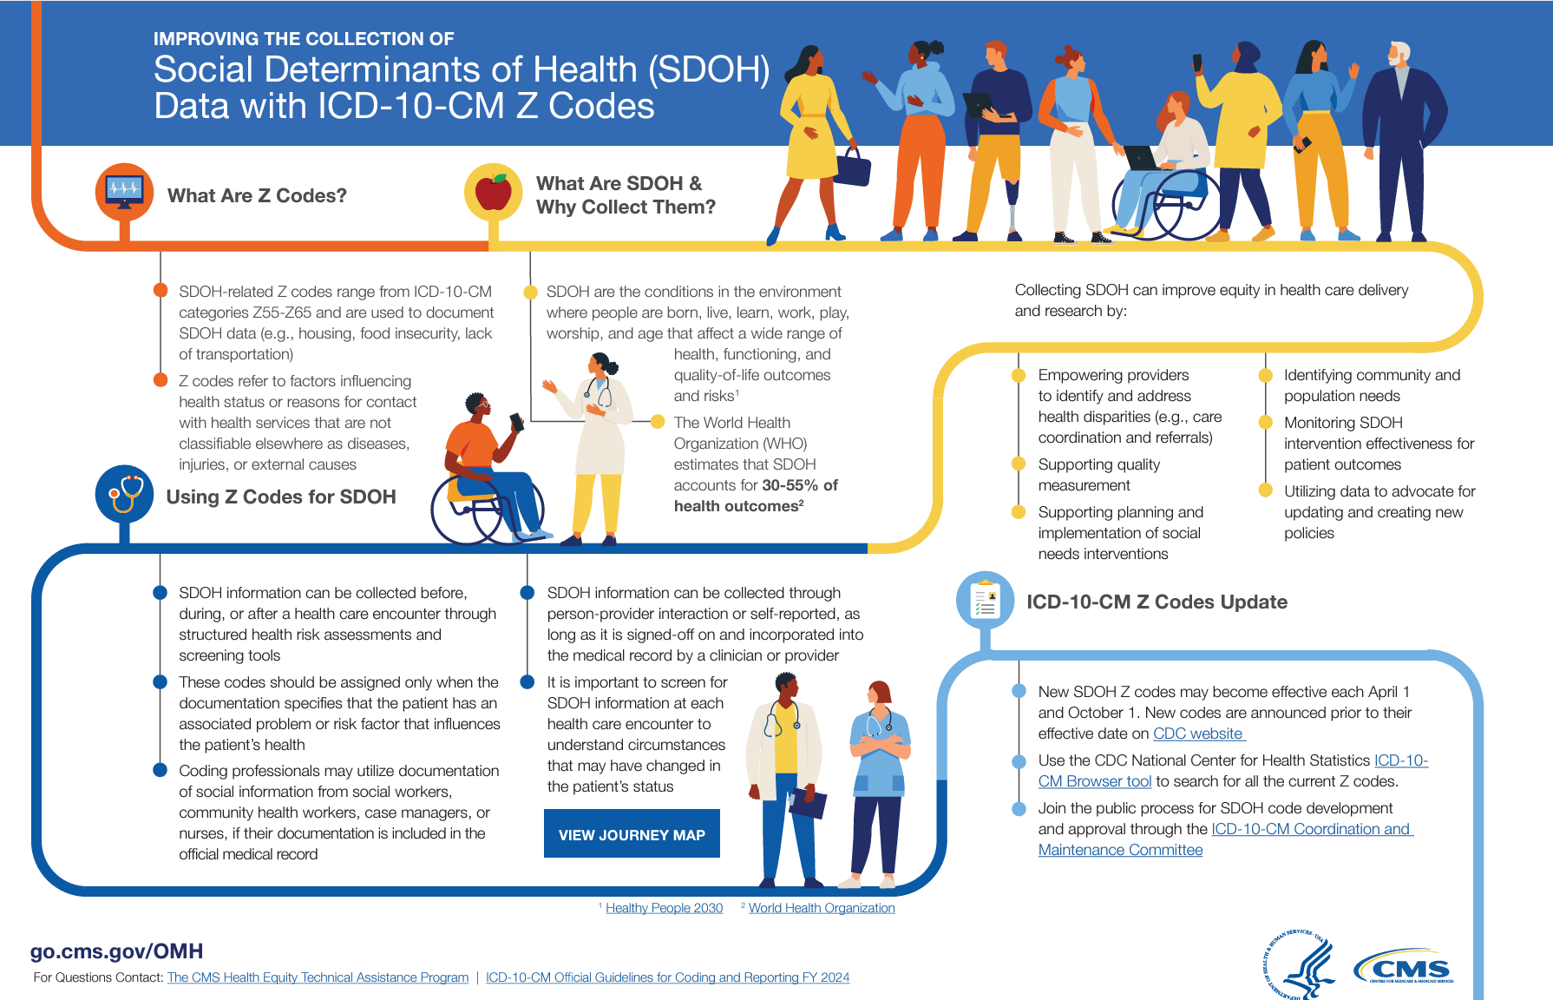
‹#›
Source: https://www.cms.gov/priorities/innovation/key-concepts/social-drivers-health-and-health-related-social-needs

Slide 20
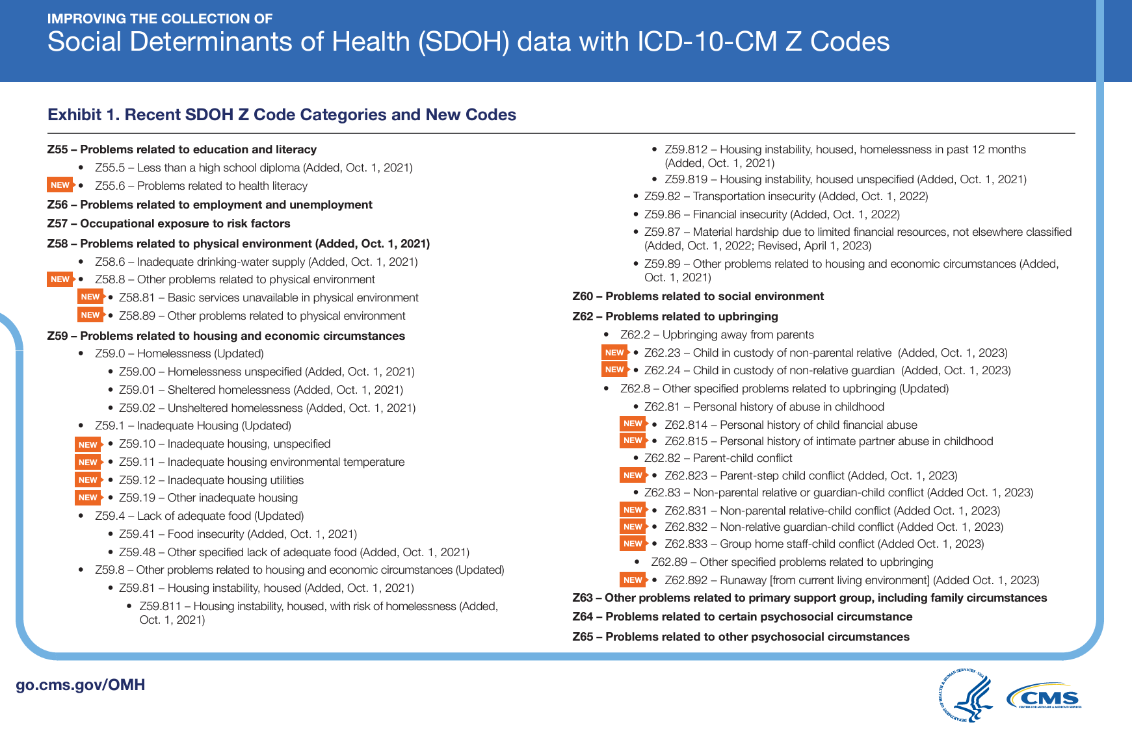

Slide 21
National Context

Slide 22

Advancing Oral Health Across the Lifespan: A Workshop
The National Academies of Sciences, Engineering, and Medicine November 18-19, 2024
Topics discussed at the workshop may include consideration of:
  National oral health goals for “Zero at Six” (zero cavities at six years of age for all children), and “Twenty at Eighty” (all 80 year olds to have 20 teeth).
  Sustainable solutions that improve access to oral health services in public and private spaces (urban, suburban, rural, and Tribal communities and territories)
  Models that achieve meaningful oral and systemic health integration.
  Models to empower all consumers to make informed choices related to oral health and models that encourage healthy workplace and school policies
  Investments in public oral health education campaigns, including celebrity and social media influencer voices
  Innovations that will improve oral health in the next 5-10 years.
A proceedings in brief of the presentations and discussions at the workshop will be prepared by a designated rapporteur in accordance with institutional guidelines.
‹#›
Source: https://www.nationalacademies.org/our-work/advancing-oral-health-across-the-lifespan-a-workshop#sectionCommittee

Slide 23
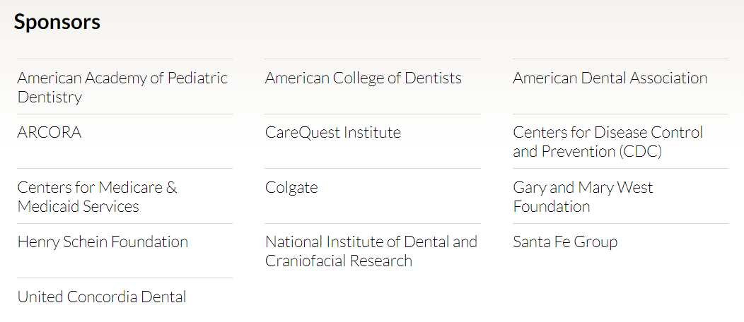
Advancing Oral Health Across the Lifespan: A Workshop
The National Academies of Sciences, Engineering, and Medicine November 18-19, 2024
‹#›
Source: https://www.nationalacademies.org/our-work/advancing-oral-health-across-the-lifespan-a-workshop#sectionCommittee

