Slide 1
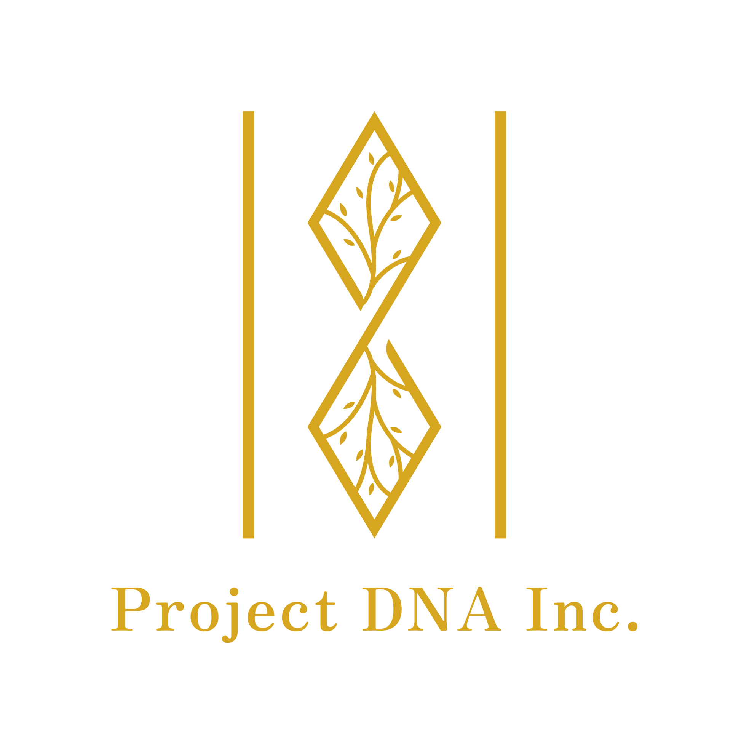
The Role of Identity in Community Wellness
Dante Howell & Lisbeth Guzman

Slide 2
About Us
Project DNA Inc is a community based program that focuses on the mental and emotional wellness of communities
Our mission is to build relationships and communities that promote the growth, expression and transformation of the un’s (the underrepresented, undervalued and unaccepted)

Slide 3
Our Philosophy
Embodiment
In order for one’s being to be well, there is a need to
Beloved (loved, appreciated, treasured)
Belong (be connected with, be a part)
Behold (recognize, understand)
Become ( grow, transform)

Slide 4
Keys to Our Approach
“The most important intervention we can engage in, is healthy relationship”- Lisbeth Guzman
Authenticity
Relationship focused
High accountability, high support
Engaging multiple parties
Use of senses and kinesthetics for engaged learning

Slide 5
Growing Need
According to the CDC Youth Risk Data Report
In 2021, more than 4 in 10 (42%) students felt persistently sad or hopeless and nearly one-third (29%) experienced poor mental health.
In 2021, more than 1 in 5 (22%) students seriously considered attempting suicide and 1 in 10 (10%) attempted suicide.
Their call to action is to increase school connectedness and implementing social emotional learning programs
https://www.cdc.gov/healthyyouth/data/yrbs/pdf/YRBS_Data-Summary-Trends_Report2023_508.pdf

Slide 6
The Role of Identity
Personal identity refers to the unique ways that you define yourself. One person might choose to emphasize their family, religion, and interests when describing their identity. A different person might emphasize their race, neighborhood, and job as important parts of who they are. Your personal identity consists of all the things that you believe make you, you
Facing History & Ourselves, “ Exploring the Concept of Identity ”

Slide 7
Identity and Mental Well-being
Identity and self-perception is a crucial part of mental well-being and how we navigate the world around us. Negative self-perception has been a consistent marker of vulnerability for depression
Self-perception:
Impacts our sense of worthiness or self worth
Impacts our ability to trust our decisions
Impacts our ability to feel capable
Impacts our worldview(s)
https://www.ncbi.nlm.nih.gov/pmc/articles/PMC5447747/

Slide 8
“The concept of identity is a complex one, shaped by individual characteristics, family dynamics, historical factors, and social and political contexts. Who am I? The answer depends in large part on who the world around me says I am. Who do my parents say I am? Who do my peers say I am? What message is reflected back to me in the faces and voices of my teachers, my neighbors, store clerks? What do I learn from the media about myself? How am I represented in the cultural images around me? Or am I missing from the picture altogether?”
Psychologist and educator Beverly Daniel Tatum
Facing History & Ourselves, “ Exploring the Concept of Identity ”

Slide 9
The Individual Impacts Community
While we have agency over how we define ourselves and what aspects of our identities we want to emphasize over others. It’s undeniable that our individual identities and social identities are intersected.
Healthy community can foster a sense of responsibility, accountability, and support that lends itself to a transformative experience.
“It takes a village to raise a child”
Notes:
Connect to the trusting self/anxiety example of how we show up: connect to the body example

Slide 10
The Individual Impacts Community
There is data that shows that people who reported having a very strong sense of community belonging were 3.21 times more likely to say they had a high level of general health and 4.95 times more likely to say they had a strong level of mental health
Compared to those that reported positive sense of community, those with a negative sense of community report higher levels of depression, anxiety and stress symptoms
“It takes a village to raise a child”
Notes:
Connect to the trusting self/anxiety example of how we show up: connect to the body example
Michalski, C. A., Diemert, L. M., Helliwell, J. F., Goel, V., & Rosella, L. C. (2020). Relationship between sense of community belonging and self-rated health across life stages. SSM - Population Health, 12, 100676. https://doi.org/10.1016/j.ssmph.2020.100676
Park EY, Oliver TR, Peppard PE, Malecki KC. Sense of community and mental health: a cross-sectional analysis from a household survey in Wisconsin. Fam Med Community Health. 2023 Jun;11(2):e001971. doi: 10.1136/fmch-2022-001971. PMID: 37399294; PMCID: PMC10314672.

Slide 11
Social Emotional Learning
We teach youth social emotional learning skills in group settings
Our group approach caters to their foundational need of belonging. As they learn the elements of emotional awareness and regulation they get an opportunity to develop social skills, boundaries and respect for one another in teamwork.
We go beyond the immediate youth group and include teachers and guardians for a integration that can extend to the classroom and home

Slide 12
Student Success
9 year old student in the second grade who had severe behavioral outburst and regulation problems. The student was separated from his parents and sibling and placed in a group home. He was often involved in fights, destroyed school property and experienced frequent emotional crisis.
Participation in our program created a safe and transformative environment that led to the student’s shift in his inner narrative and his ability to regulate and change behavior. Such as, decreased outbursts, having respect for school staff and his peers and wanting to be a positive leader.

Slide 13
Practices We Use
Affirmation to address the inner narratives:
  What do you believe and how do you perceive yourself?
Activities focused on developing self awareness, harnessing self-control, journaling and creative expression
Mindfulness techniques such as breathing regulation and meditation
Kinesthetic movement

Slide 14
5 R’s of Mindfulness
Recognize: Recognize your thoughts and internal dialogue
Relax: Explore ways to slow down, connect with your breath and calm the body and mind
Review: Review your options, What can I control, change (or not)? Do I have a choice?
Respond: Practice responding from the wisest self. What can you do in the present moment that will be the most helpful?
Return: Check-in with yourself, coming back to the present moment with awareness and curiosity
https://www.canr.msu.edu/news/the_5_rs_of_mindfulness_incorporating_mindfulness_into_everyday_life

Slide 15
Group Activity
Notes:
Attempt of 21 game, mindfulness then trying again

Slide 16
Thank You
Contact Us:
hello@projectdna.life
@projectdnainc
Notes:
Attempt of 21 game, mindfulness then trying again

