Slide 1

Responding to the Mental Health Crisis:
The Teletherapy Advantage
Dr. Michelle Floyd
Dr. Cari Whitlock

Slide 2


The Problem
Notes:
- In December 2021, the Surgeon General declared that we had a mental health crisis and published an advisory on this topic. It outlines the policy, institutional, and individual changes it will take to address long-standing challenges, strengthen the resilience of young people, support their families and communities, and mitigate the pandemic’s mental health impacts

Slide 3
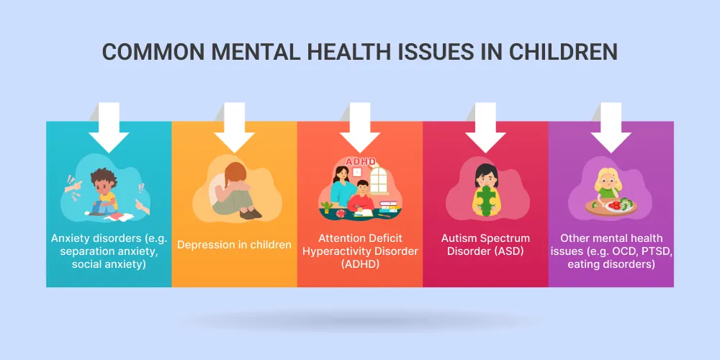
Notes:
Some of the common mental health problems face by underserved and marginalized children are ADHD, behavioral or conduct problems, depression, anxiety, and autism or developmental delays. Immigrant children have even higher rates of anxiety, post-traumatic stress disorder and adjustment disorders.

Slide 4
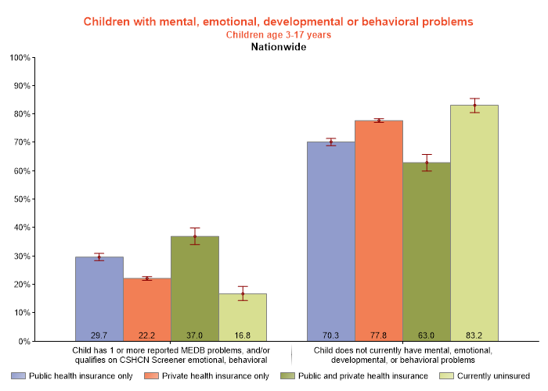
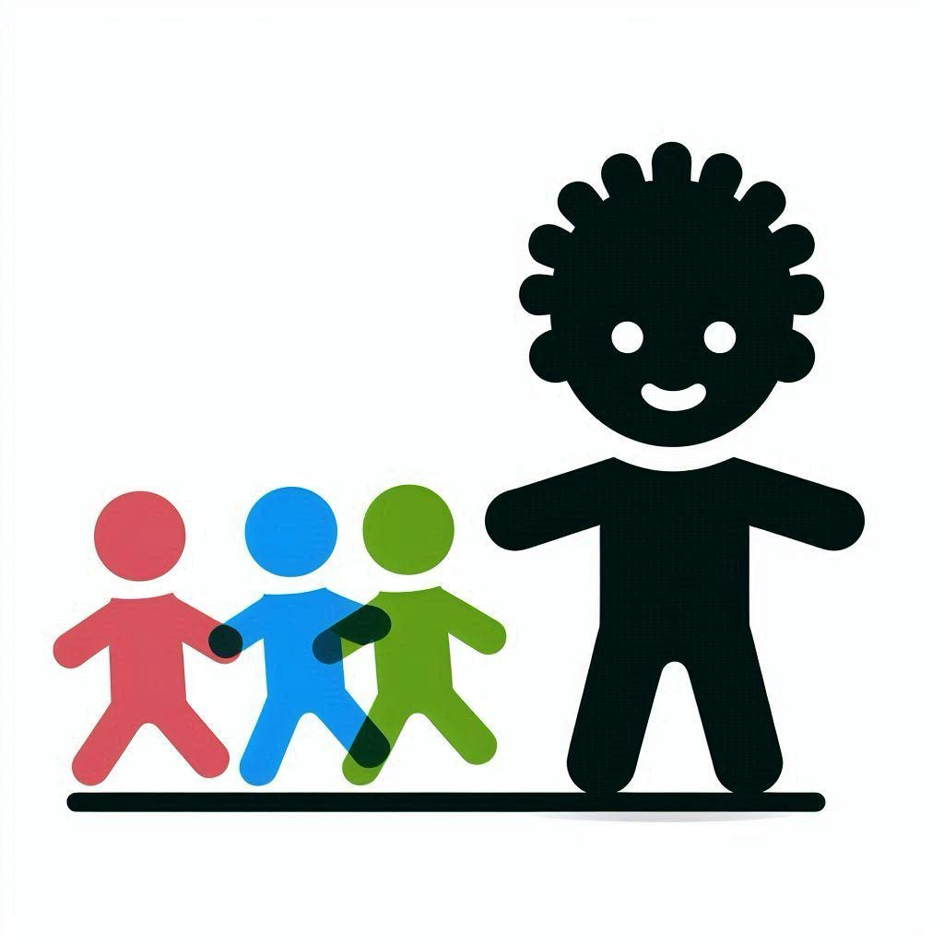
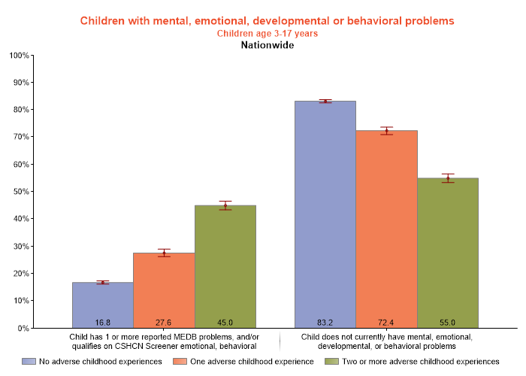
Prevalence
Notes:
- According to the National Survey of children’s health published this year, 1 out of every 4 children were found to have mental, emotional, developmental or behavioral problems. However you can see that for children with public health insurance, or Medicaid, nearly 30% of children are affected. And for those that have had two or more adverse childhood events, this number grew to 45% of all children.

Slide 5
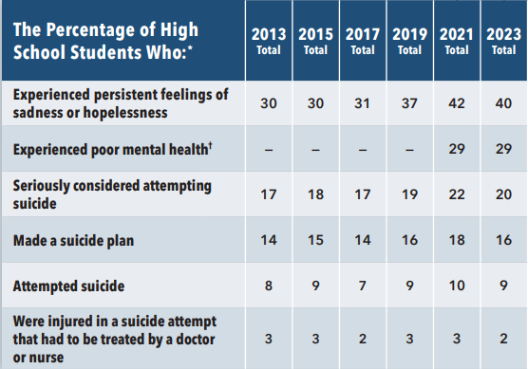
Prevalence
Notes:
This is very recent data from the Youth Risk Behavior Survey Data from 2013-2023. 4 out of 10 high school children had persistent feelings of sadness of hopeless, nearly 30% experienced poor mental health, and one in 5 children seriously considered attempting suicide.

Slide 6
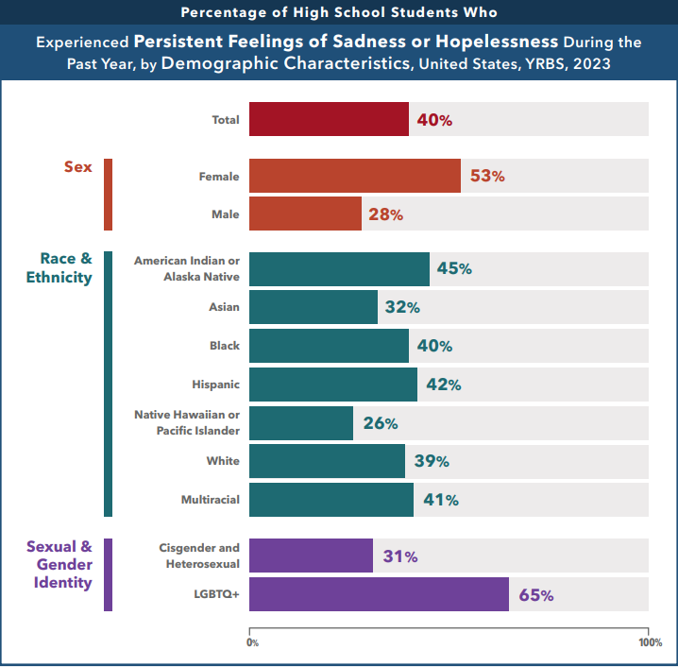
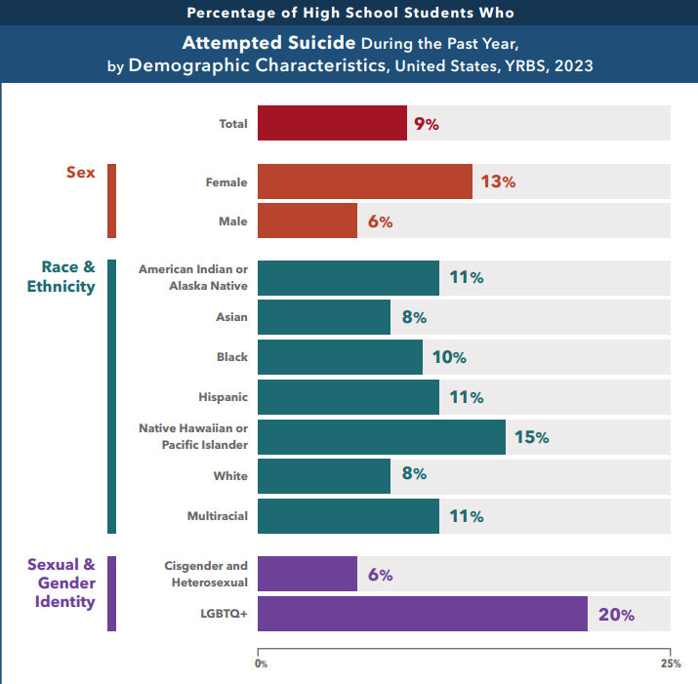
Prevalence in marginalized children
Notes:
As you can see here, more than half of all teen girls felt persistent sadness. And minority children, and especially LGBTQ children, experienced higher rates of persistent sadness and suicide attempts.

Slide 7
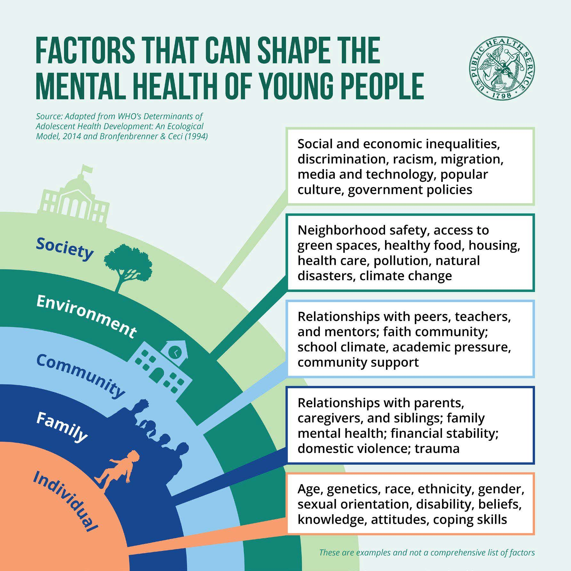
Notes:
As you can see, there are many factors that influence a child’s mental health. Some of these can be protective factors, but put children more at risk for mental health concerns when they are negative. We have seen how race, ethnicity, gender identity or sexual orientation, and adverse childhood events can increase the child´s risk for mental health problems. However, there are factors that have been shown to help a child be more resilient. Specifically, positive relationships have been shown to be a strong factor in improving child mental health

Slide 8
Additional difficulties in the underserved
Poverty
Racism and discrimination
Traumatic experiences/ Adverse Childhood Events
Toxic Stress
Food insecurity
Housing insecurity
Notes:
Poverty has been shown to be one of the largest factors influencing children’s ability to thrive. Right now, 27 million children are living below the 200% Federal poverty level, or 4 out of every 10 children
We saw earlier how discrimation and ACEs affected a child’s health mental and development
Toxic stress is defined as intense, frequent, or prolonged activation of stress response systems occurring without shielding from a supportive relationship
Discrimination against different racial, ethnic, cultural and gender-minorities has significant impacts on child mental health and development

Slide 9




Barriers to mental health care
Financial and Insurance Barriers
Cultural and Language Barriers
Systemic and Structural Barriers
Legal and Policy Barriers
Cost of care/ lack of insurance
Coverage limitations and reimbursement issues for Medicaid patients
Limited English proficiency
Cultural stigma
Shortage of providers
Geographic barriers
Fear of deportation
Policy restrictions
Administrative delays and complexities in Medicaid
Notes:
According to the national survey of children’s health, over 50% of children that had mental health or developmental needs had difficulty getting services

Slide 10





Some solutions…..
Positive relationships
Exercise
Healthy eating
Outdoor time
Adequate sleep

Slide 11

Telehealth as an option for therapy
Notes:
Several prominent leaders and experts have recommended telehealth as an option to expand mental health care. My colleague Dr. Cari Whitlock will be speaking more on this now

Slide 12

The
The Research
Telemedicine Interventions shown to be as effective as traditional methods in treating Common Mental Health Diagnoses
No significant differences between telehealth and face-to face for overall improvement in symptoms, working alliance, or client satisfaction
No difference in quality of life improvements for telehealth versus face-to-face
Effectiveness of telemedicine on common mental disorders: An umbrella review and meta-meta-analysis,Computers in Human Behavior, 2024, https://doi.org/10.1016/j.chb.2024.108325
Telehealth Versus Face-to-face Psychotherapy for Less Common Mental Health Conditions: Systematic Review and Meta-analysis of Randomized Controlled Trials
JMIR Ment Health 2022, https://mental.jmir.org/2022/3/e31780, https://doi.org/10.2196/31780
Nyssa Z. Bulkes, Kaley Davis, Brian Kay, Bradley C. Riemann,
Comparing efficacy of telehealth to in-person mental health care in intensive-treatment-seeking adults, Journal of Psychiatric Research, Volume 145, 2022, Pages 347-352, ISSN 0022-3956, https://doi.org/10.1016/j.jpsychires.2021.11.003

Slide 13
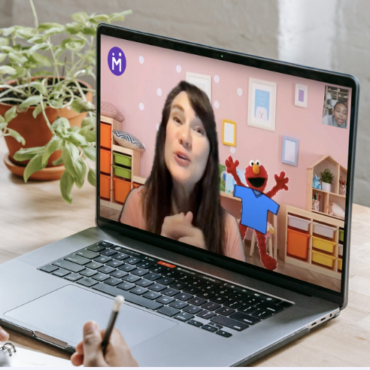
Healthy Young Minds
We founded Healthy Young Minds with the belief that every child should have what we want for our own kids: access to exceptional, effective therapeutic care online that helps every young mind achieve its greatest potential
We are passionate about making these services accessible to children and young adults ages 0-21 and provide non-physician, outpatient, mental and behavioral health care including counseling, testing, and diagnosing as well as speech, occupational, behavioral, art and music therapies.
All services are provided by master’s level licensed and certified clinicians and are personalized, evidence-based, transparent, results- driven, and deeply engaging.
– Paul Graf, Owner|CEO
Notes:
Origins story and Mission: to Serve the Underserved

Slide 14
Who We Serve
Children
Adults
Families
Treating the Family System As a Whole To Increase Effectiveness
Resiliency Skills To Improve Future Mental Health
Disrupting the Generational Cycle of Mental Health Struggles

Slide 15
Effective Methods
Highly Engaging Tools/Technological Aides for Young Children
Outcome Based Measurements
Evidence Based Treatments
  DBT
  CBT
  CBT-TF
  CPT
  EMDR
  Solutions Focused
  PCIT

Slide 16
Serving the Underserved
Increasing Access While Maintaining Quality
  Masters and Doctoral Level Providers
  Centralized Intake Process to ensure connection with the most effective treatment
  Individualized Care to meet every child’s unique needs
Notes:
Accepting Medicaid is a challenge and quality often suffers as a result. At HYM, we have developed a model that maintains high quality care

Slide 17

Focus on Diversity and Safety
Investing in our Providers
Continuing Education
  Racial Trauma
  Generational Trauma
  LGBTQ+
  Immigrant Populations
  Safety Planning And Risk Assessment
  Non-Suicidal Self-Injury
Multicultural/Multilingual Staff

Slide 18
Increasing Access/Treating the Behaviors Where They Occur
Creative Solutions to Meet the Needs of ALL Families
  Schools
  Libraries
  After-School Clubs
  Working with Children’s Services
  EI Agencies
  Pediatrician Referrals
Notes:
Collaborative efforts and partnerships

Slide 19

MEDICAID/
INSURANCE
CURRENT MEDICAID STATES
Colorado
Texas
Florida
Ohio
PRIVATE PAY STATES (MEDICAID COMING SOON)
California
Georgia
New York
Notes:
We are continually expanding

Slide 20
Healthy Young Minds Services
Psychological Services
Allied Services
Counseling
Psychological Testing
ABA
Occupational Therapy
Family Therapy
Parent Training
Speech and Language
Early Intervention
Art Therapy
Music Therapy

Slide 21



CONTACT US
WWW.HEALTHYYOUNGMINDS.COM
303 317 6504
INFO@HEALTHYYOUNGMINDS.COM

