Slide 1



THE STRATEGIC PLANNING AND EFFECTIVE COMMUNICATION IN HEALTHCARE: ENHANCING WORKPLACE JOY
Presented by:
Kemi Alli, MD Co-founder & Managing Partner
Elona Deprez, MS Co-founder & Managing Partner

Slide 2


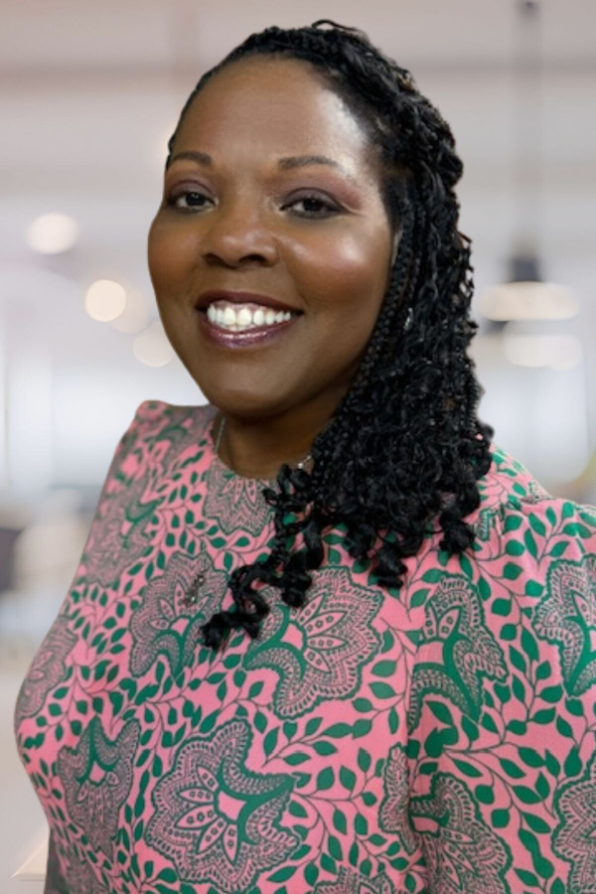





Kemi Alli, MD
New York, West Africa, New Jersey
MD, Pediatrics, MBA (-6)
25+ years in executive and medical leadership
Wife, mother, sister, daughter, niece
Elona Deprez, MS
Albania, Philadelphia, New Jersey
BS, MA, Ed.D in progress
20+ years in fundraising, strategic marketing and leadership
Wife to Nick, mama to Ben and Isaac

Slide 3


Session Agenda
Enhancing Strategic Planning: From Vision to Measured Outcomes
Understanding Joy in the Workplace: Incorporation into a Strategic Plan
Improving Communication SKills: For Effective Team Communication and Engangement

Slide 4

What is a Strategic Plan?
A Strategic Plan is a formal document or roadmap that outlines an organization’s long-term goals and the strategies and actions required to achieve them.
In short, a Strategic Plan is essential for aligning day-to-day activities with a long-term vision, ensuring that an organization stays focused on growth, adaptability, and sustainability.

Slide 5
Do you know your organization’s
Strategic Plan?

Slide 6


Strategic Plan: What is the Purpose?
Guiding Decision-Making: It acts as a reference point for leaders to make informed decisions that align with long-term goals.
Coordinating Efforts: Ensures that all departments or teams work toward common objectives.
Adapting to Change: Helps organizations remain agile by anticipating future challenges and opportunities.
Resource Management: Helps prioritize resources where they can have the most impact.

Slide 7

Strategic Plan: Key Components
Vision Statement
Mission Statement
Strategic Goals and Objectives
Needs Assessment and Analysis
Strategic Initiatives

Slide 8
Do you know your organization’s Vision and or Mission Statements?

Slide 9
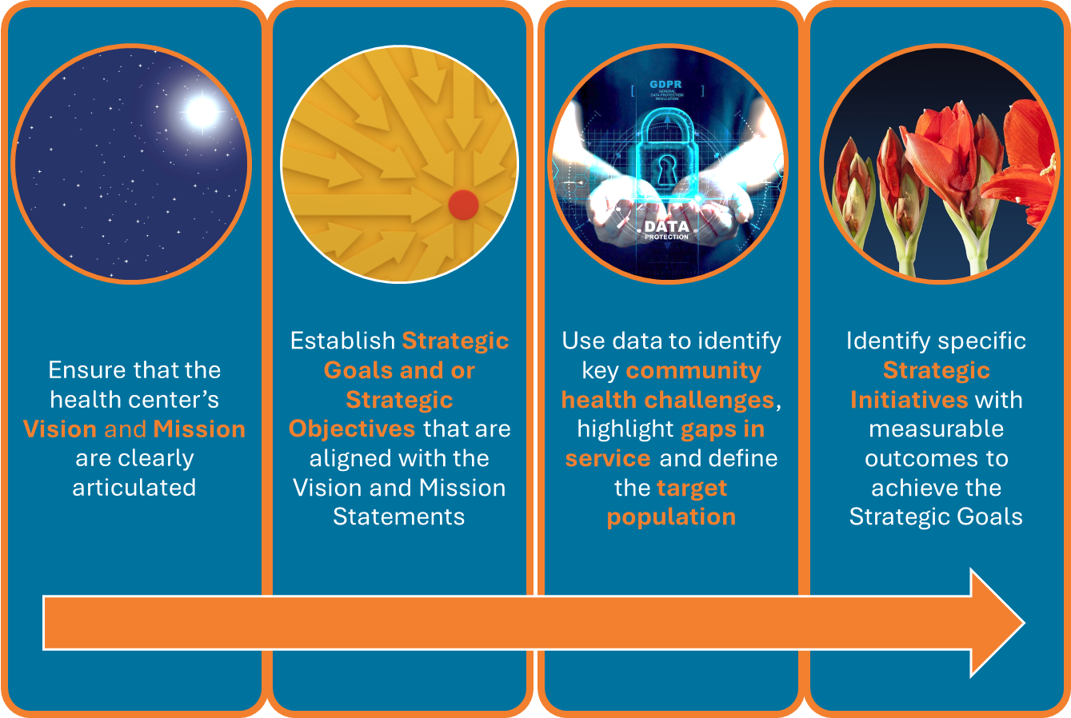
Strategic Planning: The Process

Slide 10

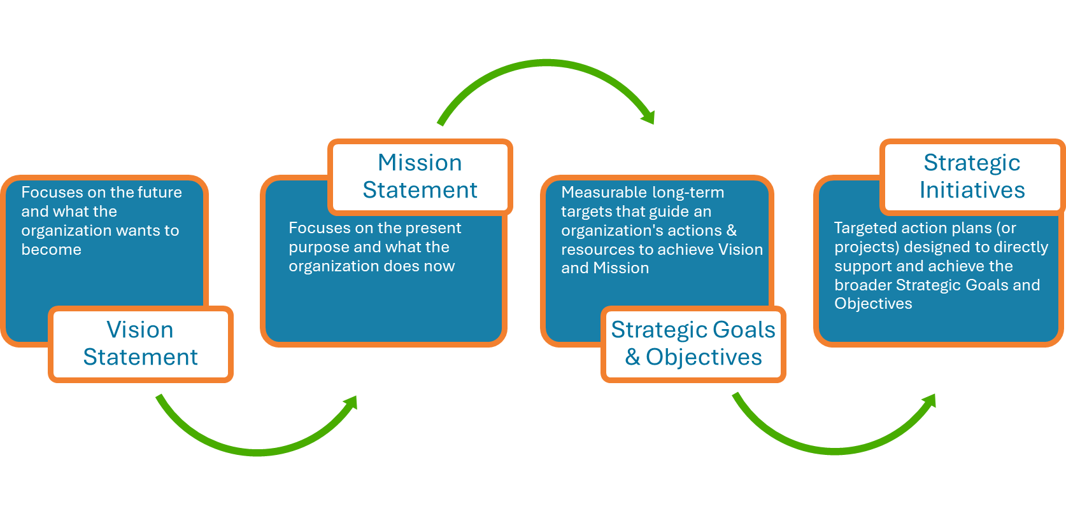
Strategic Planning: The Process

Slide 11
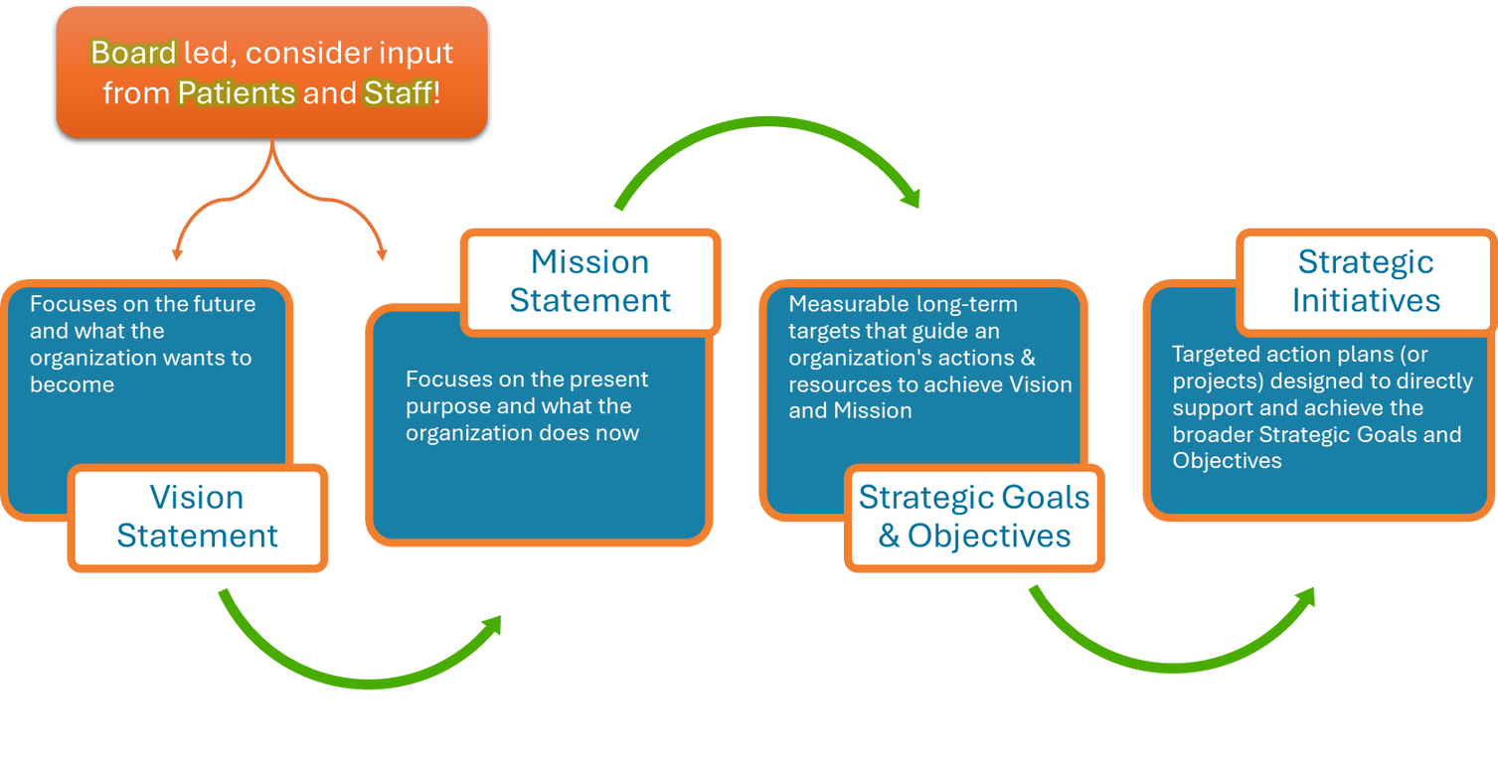
Strategic Planning: The Process

Slide 12
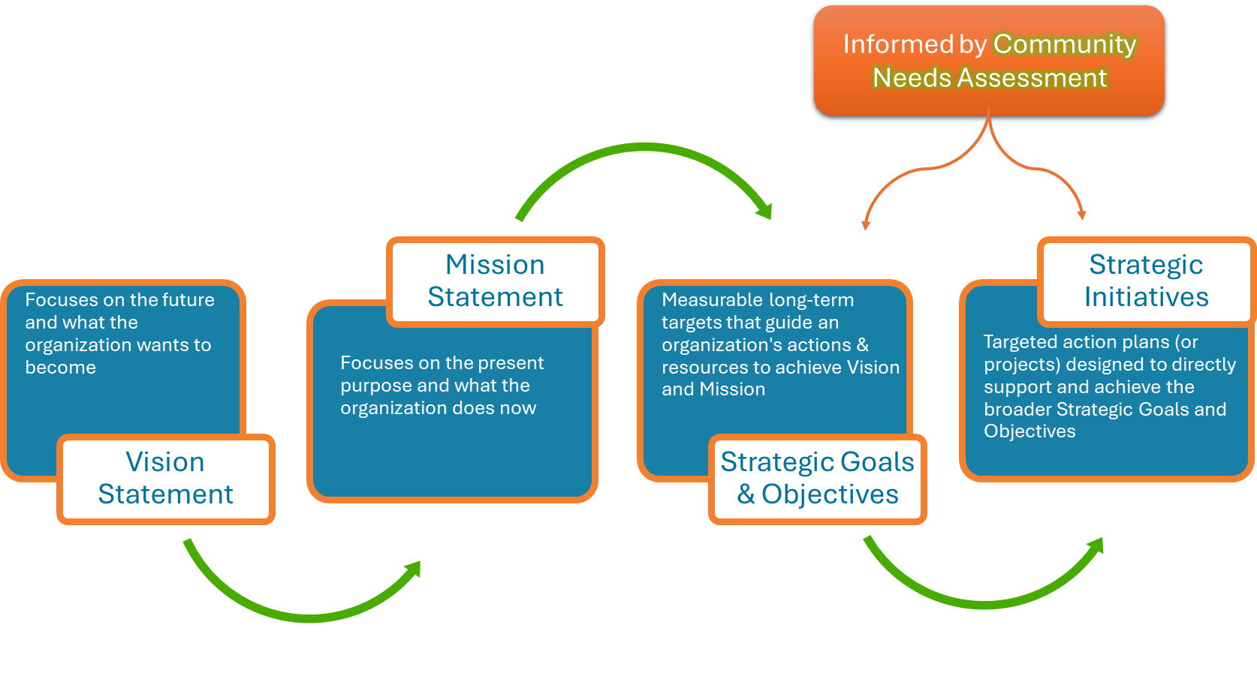
Strategic Planning: The Process

Slide 13
Do you know what are the key findings from your last Needs Assessment?

Slide 14
Let’s explore an example of
Strategic Planning

Slide 15

Nestled in the heart of the country NorthStar Community Health Center stands as a pillar of care and support for the local population, dedicated to providing high-quality, accessible healthcare for all. At NorthStar, the staff is regarded as the most valuable resource, embodying the compassion and expertise that drives the center’s mission to serve a diverse and growing community. However, like many community health centers, NorthStar faces significant challenges, from managing the demands of an ever-increasing patient load to addressing the nationwide shortage of healthcare professionals. Balancing the need for expanded services with limited resources, the center continuously strives to support its dedicated team while ensuring that no patient goes without the care they deserve.

Slide 16

Examples of Vision Statements
A: To be a national leader in accessible, compassionate, and innovative community healthcare.
B: A healthier future where quality care and equity are accessible to all.
C: To create an inclusive, thriving community through exceptional healthcare and empowered staff.

Slide 17
Examples of Mission Statements
A: Our mission is to provide high-quality, compassionate healthcare to all members of our community, prioritizing accessibility, equity, and the well-being of our patients and staff.
B: At NorthStar Community Health Center, we are dedicated to delivering comprehensive, patient-centered care, fostering health and wellness through collaboration, innovation, and unwavering commitment to those we serve.
C: We strive to improve the health of our community by offering affordable, inclusive healthcare services, while empowering our staff to deliver excellence in every aspect of patient care.

Slide 18

Developing Strategic Goals and Objectives
When developing Strategic Goals consider broad, overarching goals that align with national frameworks such as the Quadruple AIM, the National Association of Community Health Centers, or state health department priorities. By focusing on goals that resonates with national and or regional health agendas, this positions the center as a collaborative entity that can more easily attract funding opportunities. Funders and grant-making organizations are often drawn to projects that demonstrate alignment with national goals and public health priorities, as they offer measurable impact on larger, systemic issues - making the organization more attractive candidate for support.

Slide 19


Examples of Strategic Goals
Quadruple AIM
  Improve Patient Experience
  Improve Provider Satisfaction
National Association of Community Health Centers
  Equity and Social Justice
  Skilled and Mission-Driven Work Force

Slide 20
Examples of Strategic Goals & Objectives
Goal I: Enhance Patient Experience
Goal II: Enhance Staff Experience
Goal III: Improve Patient Health Outcomes
Improve patient satisfaction by 20% over the next three years through expanded services, personalized care, and streamlined access to appointments
Cultivate joy in the workplace by implementing initiatives that promote Meaning and Purpose; Physicial and Psychological Safety; and Camaraderie and Teamwork, aiming to increase overall staff well-being and engagement by 25% within three years.
Reduce preventable chronic illnesses by 15% in five years by increasing outreach, screenings, and preventive care programs.

Slide 21
Examples of A Strategic Goal & Objectives
Goal I
Enhance Staff Experience
Objectives under Strategic Goal I:
  Promote Organization Meaning and Purpose
  Improve Physical and Psychological Safety
  Promote Camaraderie and Teamwork
Cultivate joy in the workplace by implementing initiatives that promote Meaning and Purpose; Physicial and Psychological Safety; and Camaraderie and Teamwork, aiming to increase overall staff well-being and engagement by 25% within three years.
Measure: Increase overall staff well-being and engagement by 15% within three years.

Slide 22
What is next in the strategic planning process after creating the Strategic Goals and or Strategic Objectives?

Slide 23
Strategic Planning: The Process

Slide 24

Developing Strategic Initiatives
When developing Strategic Initiatives consider evidence-based tools, guidelines, or frameworks. For Example the The Joy in Work Model by the Institute for Healthcare Improvement (IHI) is an initiative designed to improve the well-being of healthcare professionals by fostering a culture that enhances engagement, satisfaction, and purpose in the workplace. Recognizing that burnout and dissatisfaction are pervasive in healthcare, IHI developed this model to help organizations create environments where staff feel valued, supported, and empowered, leading to better care for patients.
Notes:
https://www.ihi.org/resources/white-papers/ihi-framework-improving-joy-work#downloads
https://bmjleader.bmj.com/content/7/3/178

Slide 25
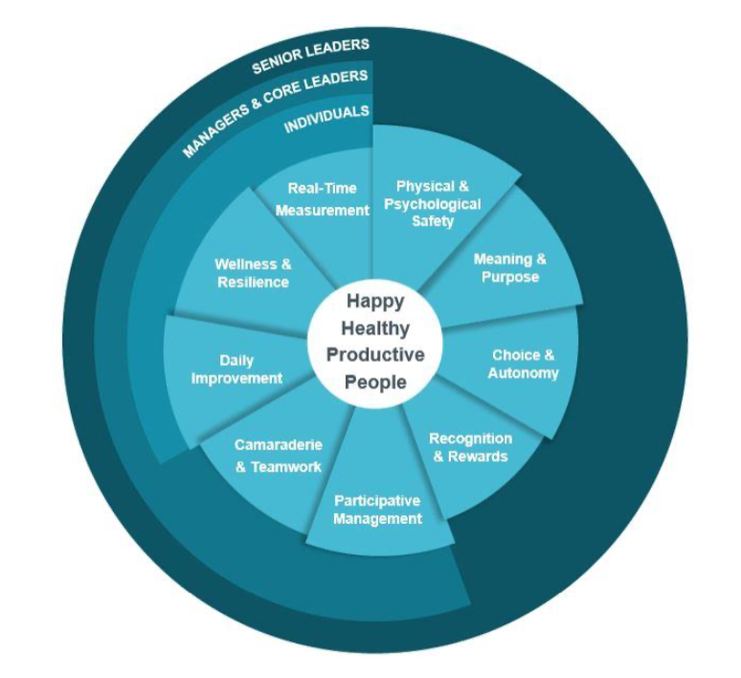

Through a four step approach, critical issues can be identified that must be addressed with the greatest attention if we really want to decrease burnout and increase joy.
Note
THE RINGS

Slide 26
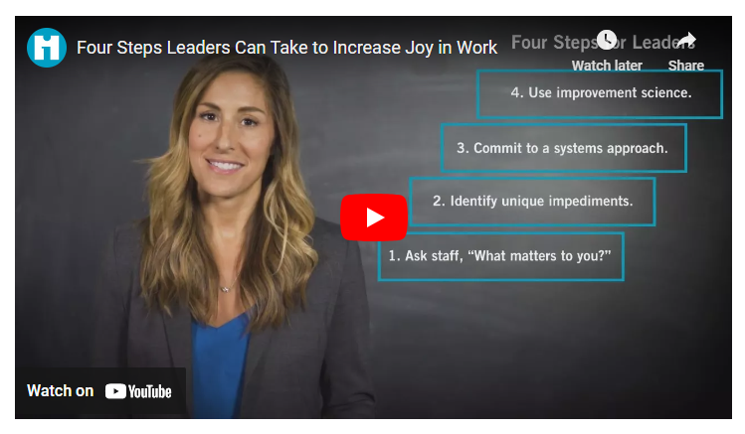

Slide 27
Four steps to start the Joy in Work Model
Understand What Matters:
Ask staff, “what matters to you?”
Remove Barriers:
Ask staff, “ what impedes your ability to do your best?”
Systems Approach:
Use a systems approach to tackle improvement projects
Use Improvement Science:
Measure and test approaches and celebrate what you do

Slide 28

Benefits of the Joy in Work Model
Improved Employee Retention:
By enhancing job satisfaction, organizations can reduce turnover and burnout.
Enhanced Patient Care:
Staff who experience joy in their work are more engaged and better able to provide high-quality, compassionate care.
Better Organizational Perfomrance:
Engaged and satisfied staff are more productive, contributing to overall organizational success.

Slide 29
Strategic Planning: The Process
Notes:
Show this slide again as a reminder before going on to speak on the strategic Objectives that lead to Strategic Initiatives.

Slide 30
Examples of A Strategic Goal & Objectives
Goal II Enhance Staff Expereince
Objectives under Strategic Goal II:
  Promote Organization Meaning and Purpose
  Improve Physical and Psychological Safety
  Promote Camaraderie and Teamwork
Cultivate joy in the workplace by implementing initiatives that promote Meaning and Purpose; Physicial and Psychological Safety; and Camaraderie and Teamwork, aiming to increase overall staff well-being and engagement by 25% within three years.
Measure: Increase overall staff well-being and engagement by 15% within three years.

Slide 31
What are some initiatives to achieve Objective 2, Improve Physical and Psychological Safety?

Slide 32

Strategic Plan: The Initiatives
Action Plans: Outlines the detailed steps required to reach the objectives.
Key Performance Indicators: Establishes the metrics to measure progress and success.
Timeline: Specifies deadlines and phases for the initiatives.
Resource Allocation: Identifies the resources (financial, human, and technological) needed to execute the initiatives.

Slide 33
Examples Initiatives for Objective 2
Goal II: Enhance Staff Expereince
Enhanced Safety Protocols and Ergonomics: Implement workplace safety enhancements, including upgraded ergonomic equipment, safety training, and clear protocols for managing physical hazards. Regular staff feedback and assessments will ensure that the work environment meets safety standards and reduces the risk of injury or physical discomfort.
Peer Support and Mentorship Networks: Create peer support and mentorship programs that provide a safe space for employees to discuss challenges and share experiences. This initiative would enhance psychological safety by fostering collaboration, reducing isolation, and building a stronger sense of community within the workplace.
Objectives under Strategic Goal II:
  Promote organization Meaning and Purpose
  Improve Physical and Psychological Safety
  Promote Camaraderie and Teamwork
Measure: Increase overall staff well-being and engagement by 15% within three years.

Slide 34
How do we Communicate all of “this”?

Slide 35
Improving Communication Techniques
  Effective communication is vital for organizational success, employee engagement, and patient outcomes.
  According to a study by the Institute for Healthcare Improvement (IHI), organizations with strong internal communication experience 47% higher employee engagement and 23% lower turnover rates (IHI, 2023).
  Transparent communication fosters trust, reduces misunderstandings, and empowers employees to contribute meaningfully.
Notes:
Who is responsible for the different asects in the process

Slide 36
What communication challenges do you currently face in your organization?

Slide 37
What is integrated marketing?

Slide 38
What is an integrated marketing campaign?
A) A campaign that ensures consistency in messaging across multiple platforms
B) A campaign that uses both digital and traditional marketing channels
C) A campaign that creates a unified customer experience
D) A campaign that leverages data to optimize performance
E) All of the above

Slide 39
Monthly Strategic Initiative Meetings
  Purpose: Align teams on progress and upcoming projects to ensure everyone is informed and engaged in strategic planning.
  Best Practices:
    Use a structured agenda to stay on track.
    Share visual updates (graphs, progress bars) to represent progress.
    Include time for Q&A to address any concerns or suggestions.
  Benefits: Promotes transparency, encourages accountability, and ensures alignment with organizational goals.
GIVE IT A FUN NAME!

Slide 40
Monthly E-Newsletter
  Purpose: Provide regular updates on organizational news, highlight employee achievements, and communicate important changes.
  Best Practices:
    Include a mix of content: strategic updates, employee spotlights, upcoming events.
    Use engaging visuals and short, digestible articles.
    Ask for employee contributions to increase engagement.
  Benefits: Keeps everyone informed and connected, reduces information silos, and fosters a sense of community.

Slide 41
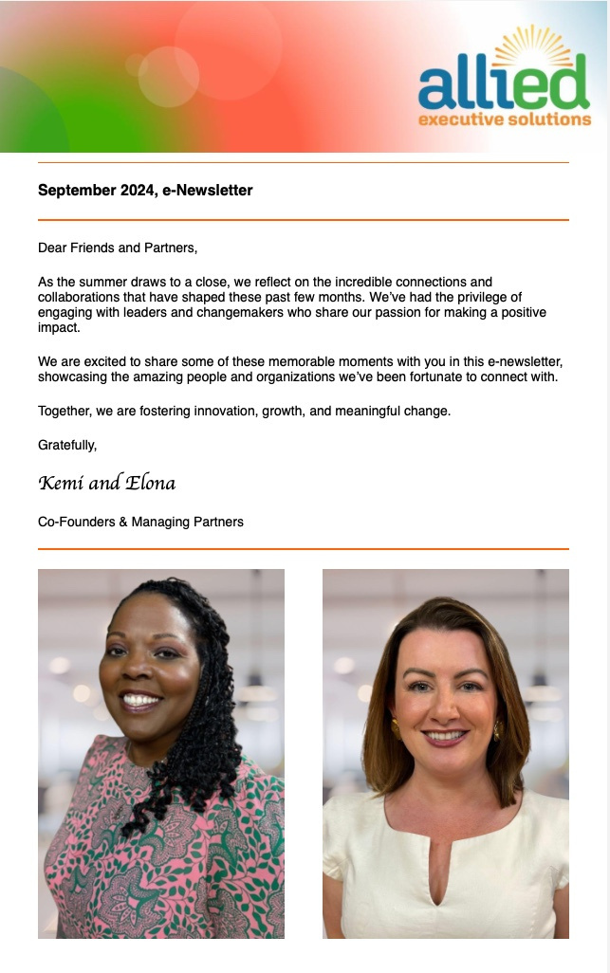
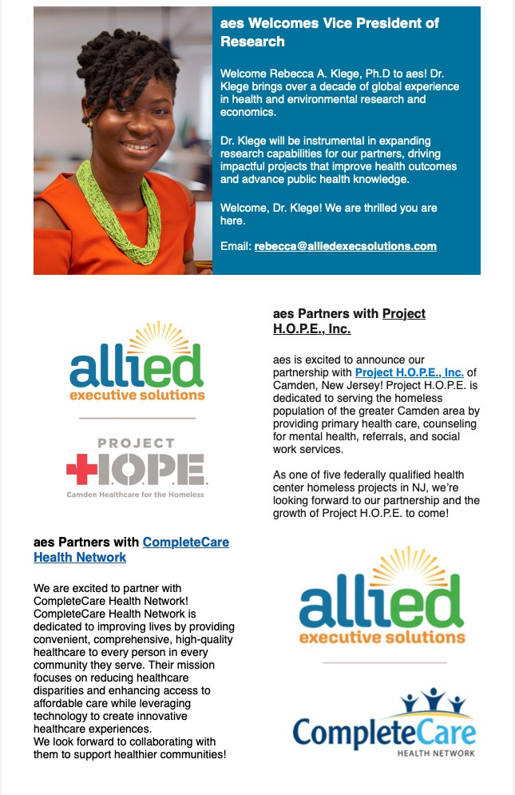
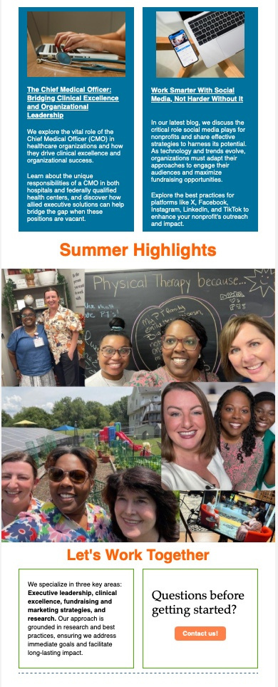

Slide 42

Monday Townhall Meetings
  Purpose: Quick updates on key organizational activities, celebrate successes, birthdays, special events, and provide a platform for Q&A.
  Best Practices:
    Keep the meeting to 30 minutes to respect everyone's time.
    Use a consistent format for updates to maintain structure.
    Rotate leadership or department speakers to ensure diverse perspectives.
  Benefits: Fosters a sense of community, increases visibility of leadership, and ensures everyone is on the same page.
Notes:
Added a photo

Slide 43

In-Service Events
  Purpose: Provide opportunities for professional development, team-building, and knowledge sharing.
  Best Practices:
    Include interactive workshops and guest speakers.
    Allow time for networking and informal discussions.
    Collect feedback to continuously improve future events.
  Benefits: Boosts employee engagement, fosters professional growth, and builds a positive organizational culture.
Notes:
Organizations may not know what an In-Service event is. This is a term HJA made up.
Added a photo

Slide 44
Internal Website/Hub
  Purpose: Serve as a centralized location for important announcements, collaboration, resources, and communication tools.
  Best Practices:
    Ensure easy navigation and user-friendly design.
    Include sections for training resources, communication requests, and employee spotlights.
    Regularly update content to keep it relevant.
  Benefits: Enhances information access, reduces email overload, and provides a reliable source for all organizational communications.

Slide 45
Additional Communication Techniques
  Employee Suggestion Boxes or Anonymous Feedback Forms: Encourage open communication and gather insights on organizational improvements.
  Regular One-on-One Meetings: Build stronger relationships and address individual concerns or development needs.
  Peer Recognition Programs: Recognize and celebrate contributions and successes across teams.
  Cross-Departmental Collaboration Forums: Encourage collaboration between departments through dedicated sessions or events.

Slide 46
What other strategies can be implemented?

Slide 47
Who has the first Question ?

Slide 48

Kemi Alli, MD
kemi@alliedexecsolutions.com
Elona Deprez, MA
elona@alliedexecsolutions.com

